Slide 1
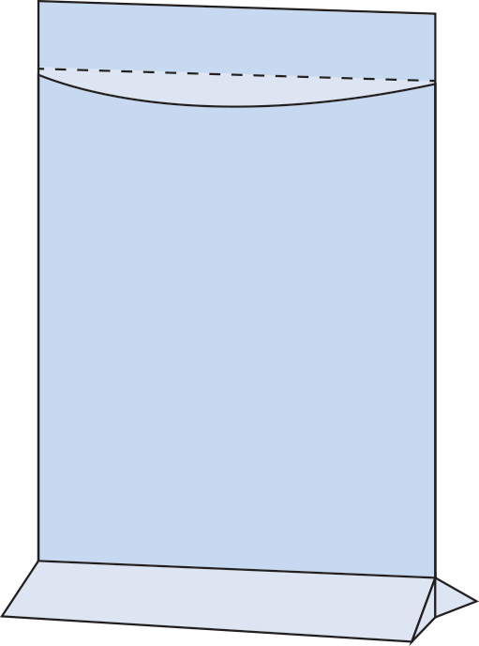
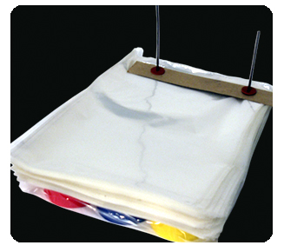
WICKETED BAGS
Information Needed:
HDPE or LDPE?
Clear or Colored Film?
Additives: VCI/Anti-Static/Metallocene/ UVA/UVI?
Layflat or Bottom Gusseted?
Size?
Gauge?
Lip Size?
Perforated Lip? Y/N
Wicket Length?
Space between Wickets?
Tear Starts? Y/N
Cardboard Header? Y/N
Hang hole? Y/N
Vented? Vent Placement?
Printed? # Colors? # Sides? Artwork Size?
Bags per Wicket?
Case Pack?
Quantity?
Lip
Lip Perf
Space Between Wickets
Tear Start
Wicket Hole
Opening
Length
Bottom Gusset
(measured fully
opened)
Width
Wire Wickets
Cardboard Header

