Slide 1
Insert steps/screens for initiating a request in Avante.

Slide 2
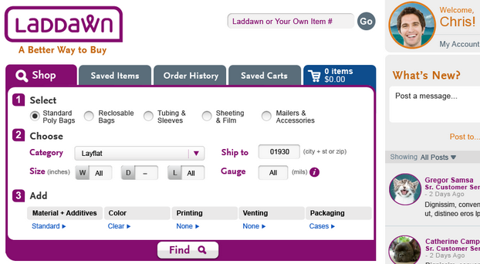
030 – sales order 130 – convert quote
IIs this a reorder? Are the items in ‘saved items’ or a cart?
In a hurry? No interest in YMAC? Use cart quick add.
070 – stock check*
### – Shop
080 – price check*
110– custom quote
*Basic functions only; advanced functions remaining in Avante (as new request types?)

