Slide 1
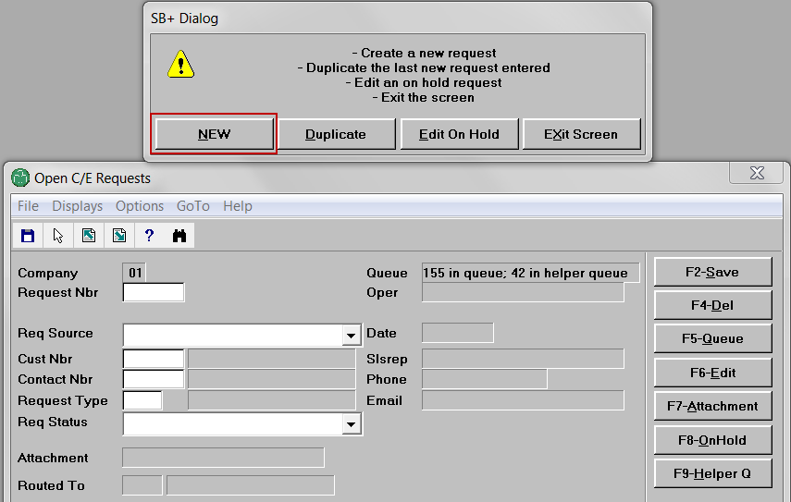
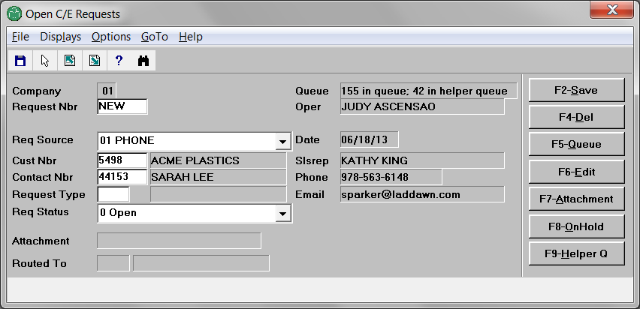
Sarah calls Laddawn for a price check on item 2874. Michael answers.
Michael opens workflow in Avante. Opens C/E requests. Creates new request.
Leaves req source as phone. Enters customer number (Acme). Enters contact (Sarah).

Slide 2
Next, instead of doing this…

Slide 3
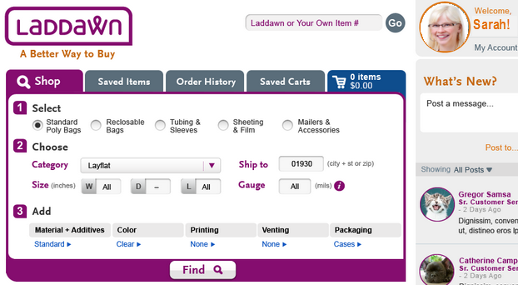
Michael selects new request type that logs him into web as Sarah. He enters item number and zip.
2898

Slide 4
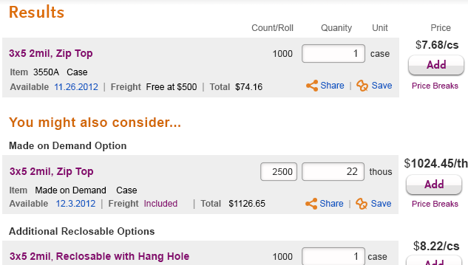
Clicking Find generates results like this:
This sequence of steps also works for the following request types…

Slide 5
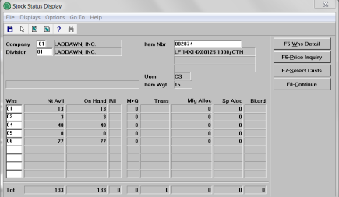
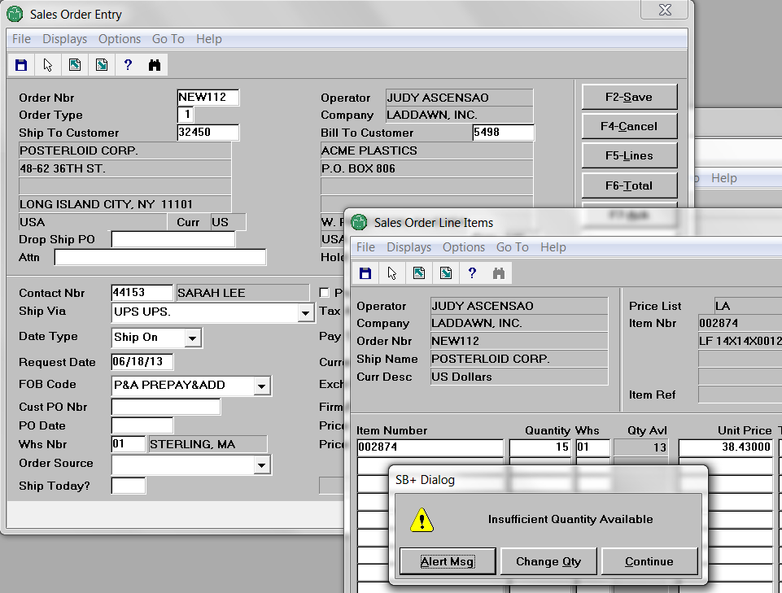
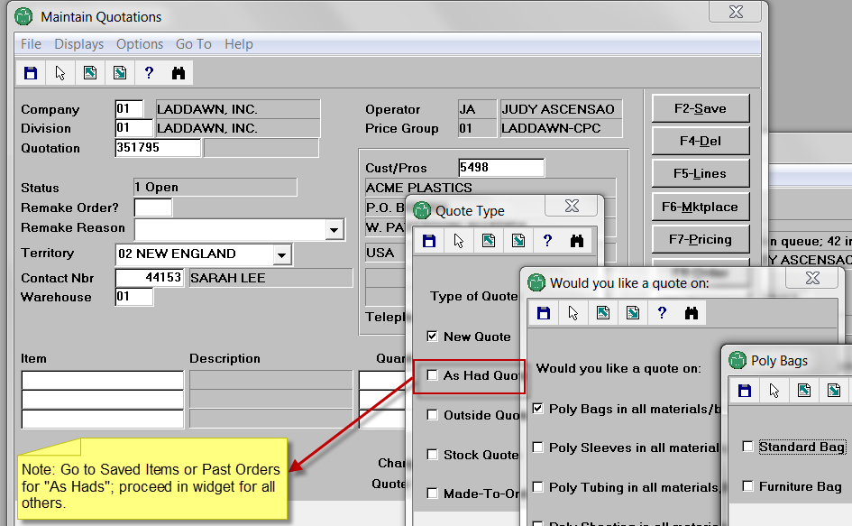
070 – stock check
030 – sales order
110 – custom quote

Slide 6
Conversations and perception can dictate 1-click detours, once Michael is logged in
030 – sales order
IIs this a reorder? Go to Order History. Is this something Sarah or someone in her organization recently called about or priced on the web? Go to Saved Items or Saved Carts.
In a hurry? No interest in YMAC? Use cart quick add.
070 – stock check
080 – price check
IIs this an “as had”? Go to Saved Items or Order History.
110– custom quote

