Slide 1
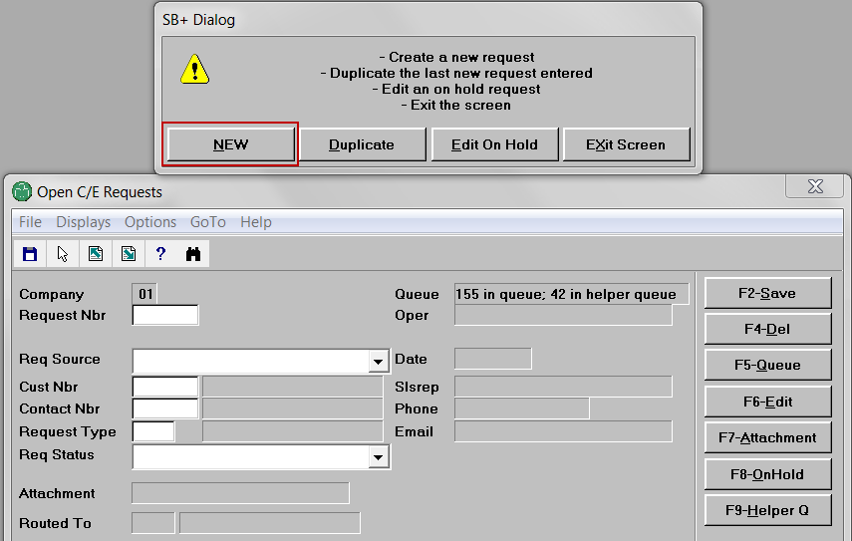
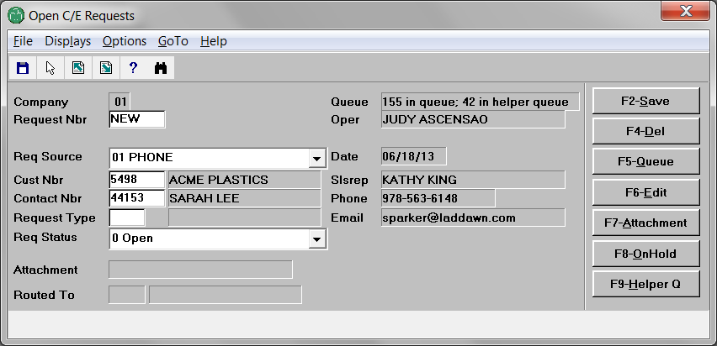
Sarah calls Laddawn to request current pricing for item 2874.
Michael answers. He opens workflow in Avante. Opens C/E requests. Creates new request.
Leaves req source as phone. Enters customer number (Acme). Enters contact (Sarah).

Slide 2
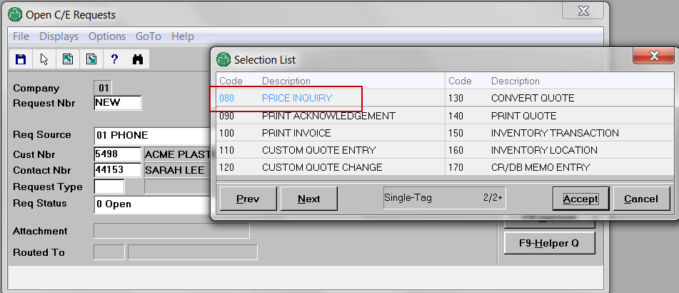
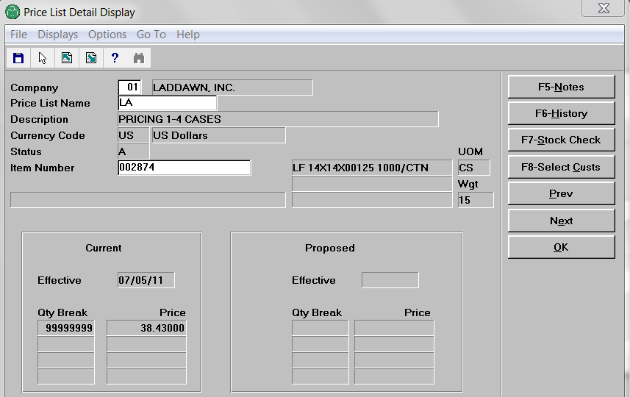
Next, instead of doing this…
F3

Slide 3
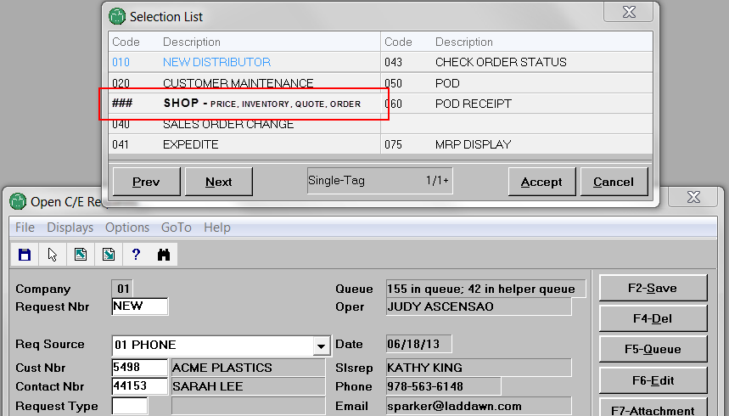
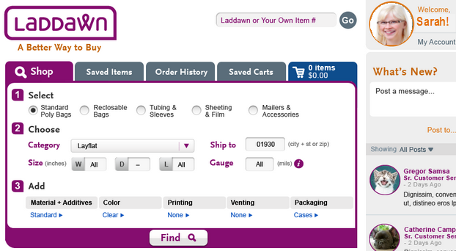
Michael selects new request type that logs him into web as Sarah. He enters item number and zip.
2898
He clicks “Find”

Slide 4
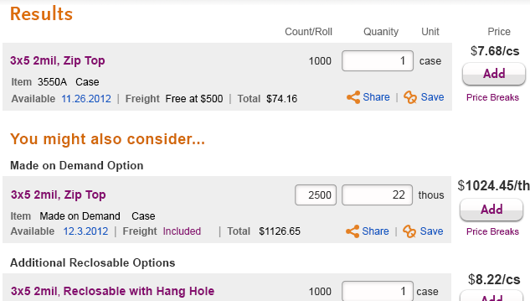
Clicking Find generates results like this (just pretend it’s a 14 x 14 layflat in cases):
This sequence of steps also works for the following request types…

Slide 5
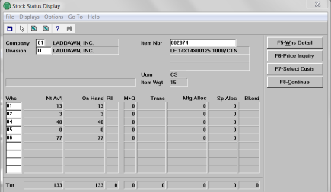
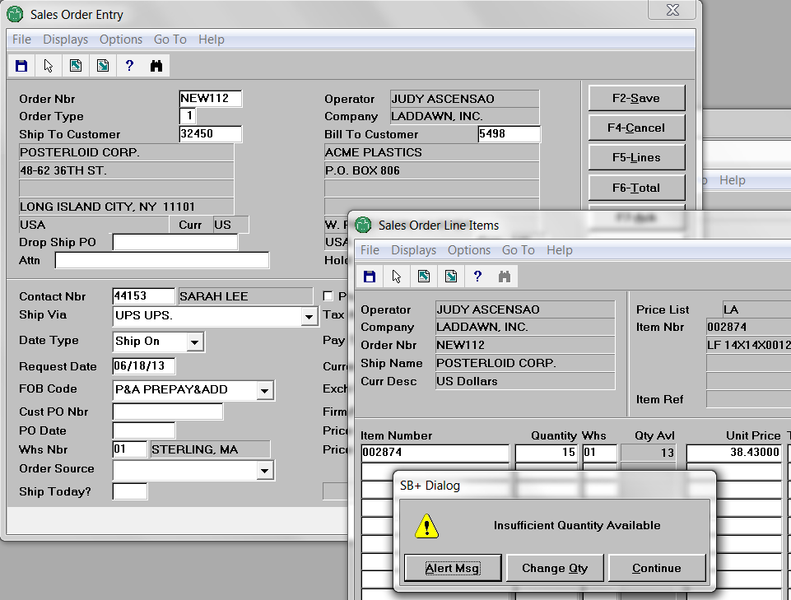
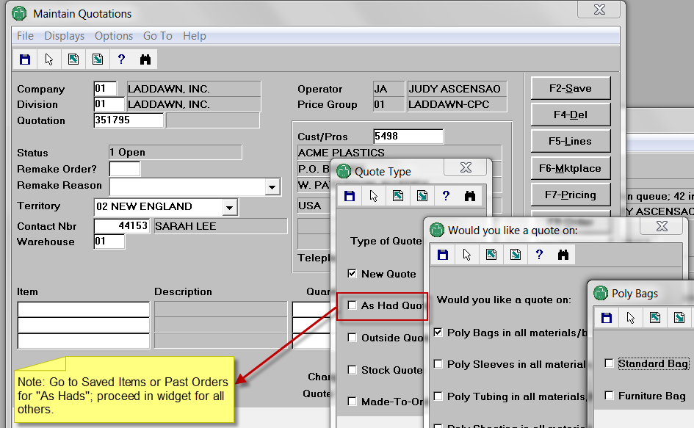
070 – stock check (basic – still need Avante req for advanced functions)
030 – sales order (address insufficient quantity at checkout)
110 – custom quote

Slide 6
Conversations can dictate 1-click detours, once Michael is logged in
IIs this a reorder? Go to Order History. Is this something Sarah or someone in her organization recently called about or priced on the web? Go to Saved Items or Saved Carts (or scan the thread).
030 – sales order
In a hurry? No interest in YMAC? Use Cart “Quick Add.”
030 – sales order
070 – stock check
080 – price check
IIs this an “as had”? Go to Saved Items or Order History.
110– custom quote

