Slide 1
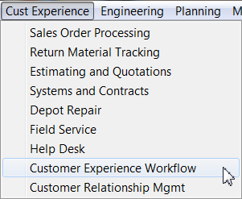
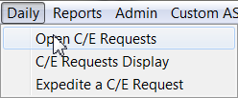
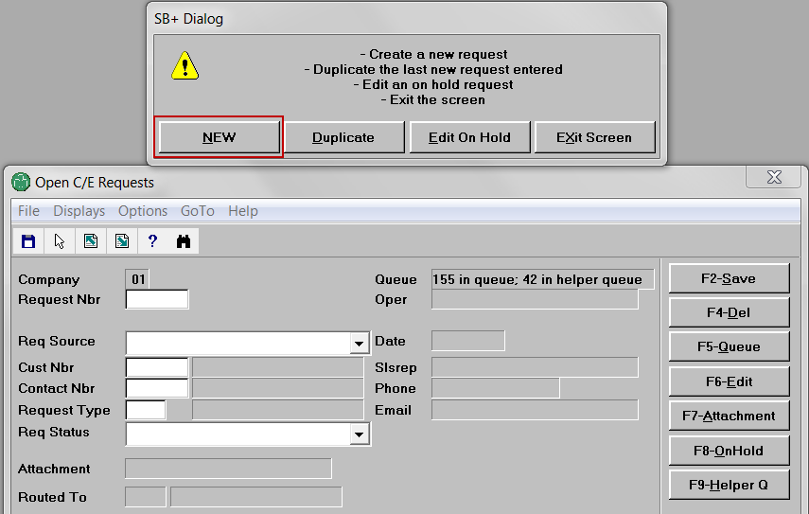
Sarah calls Laddawn to request current pricing for item 2874.
Michael answers.
He opens workflow in Avante.
He opens C/E requests.
He creates new request.

Slide 2
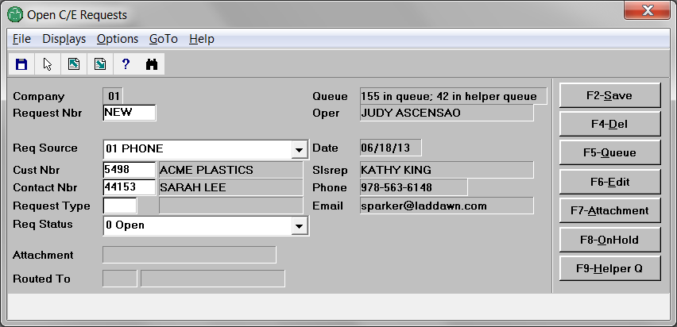
He leaves request source as phone. He enters customer number (Acme). He enters contact (Sarah).

Slide 3
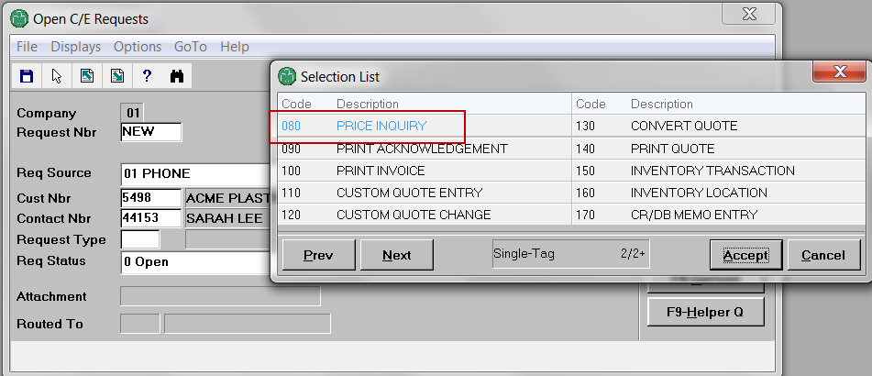
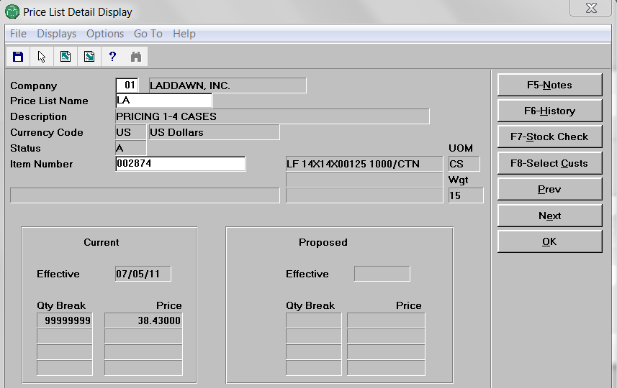
Next, instead of doing this…
F3

Slide 4
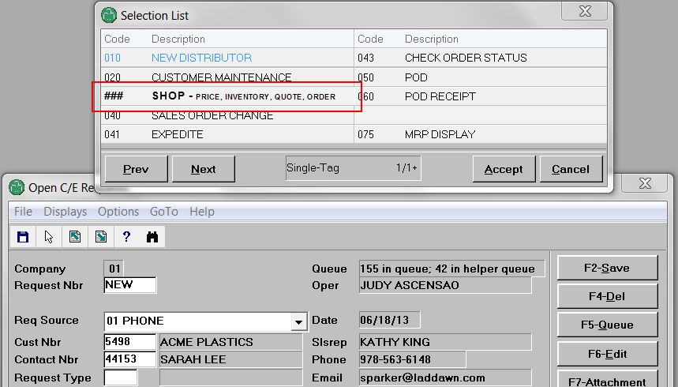
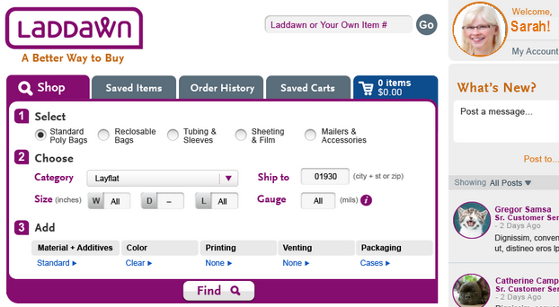
Michael selects new request type that logs him into web as Sarah. He enters item number and zip.
2898
He clicks “Find”

Slide 5
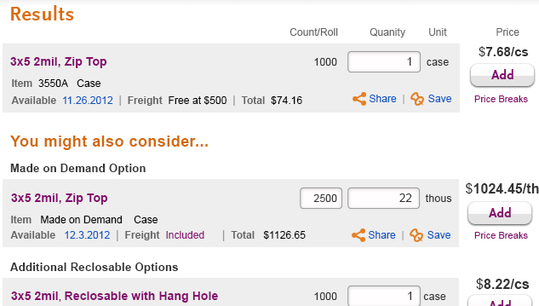
Clicking Find generates results like this (just pretend it’s a 14 x 14 layflat in cases):
This sequence of steps also works for the following request types…

Slide 6
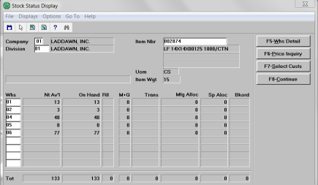
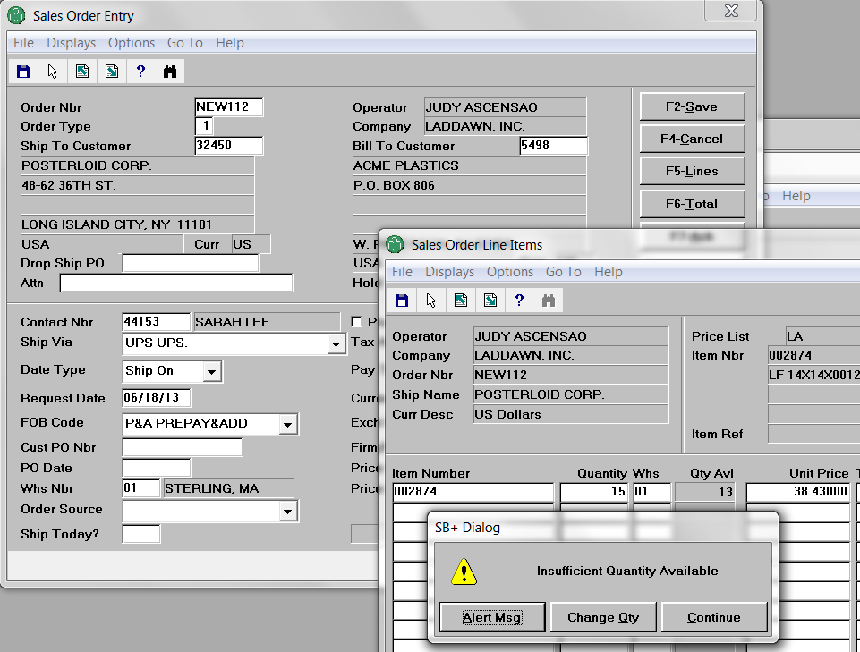
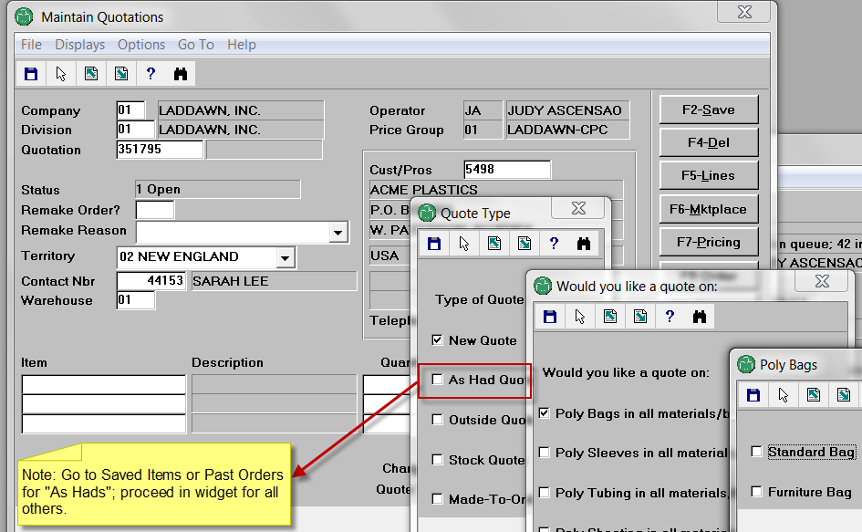
070 – stock check (basic – still need Avante req for advanced functions)
030 – sales order (address insufficient quantity at checkout)
110 – custom quote

Slide 7
Conversations can dictate 1-click detours, once Michael is logged in
IIs this a reorder? Go to Order History. Is this something Sarah or someone in her organization recently called about or priced on the web? Go to Saved Items or Saved Carts (or scan the thread).
030 – sales order
In a hurry? No interest in YMAC? Use Cart “Quick Add.”
030 – sales order
070 – stock check
080 – price check
IIs this an “as had”? Go to Saved Items or Order History.
110– custom quote

Slide 8
Move to the web
030 SALES ORDER ENTRY
070 STOCK CHECK BASIC
080 PRICE INQUIRY BASIC
110 CUSTOM QUOTE ENTRY
120 CUSTOM QUOTE CHANGE
130 CONVERT QUOTE
030? 03X? “SHOP” > Shop tab
~ 70% of requests
043 CHECK ORDER STATUS
050 PROOF OF DELIVERY
043? 04X? “CHECK ORDER” > Order History Tab
Keep in Avante
TBD
040 SALES ORDER CHANGE (10%)
041 EXPEDITE
060 POD RECEIPT
070 STOCK CHECK ADVANCED
075 MRP DISPLAY
080 PRICE INQUIRY ADVANCED
160 INVENTORY LOCATION
170 CR/DB MEMO ENTRY
180 CR/DB MEMO CHANGE
190 RA ENTRY
200 RA CHANGE
210 RA INQUIRY
220 RA ACKNOWLEDGMENT
230 GENERAL
090 PRINT ACKNOWLEDGMENT
100 PRINT INVOICE
140 PRINT QUOTE
~ 30 % of requests

