Slide 1


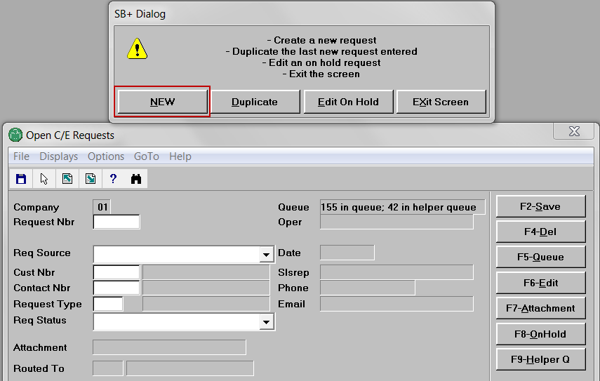
Sarah calls Laddawn to request current pricing for item 2874.
Michael answers.
He creates new request.

Slide 2
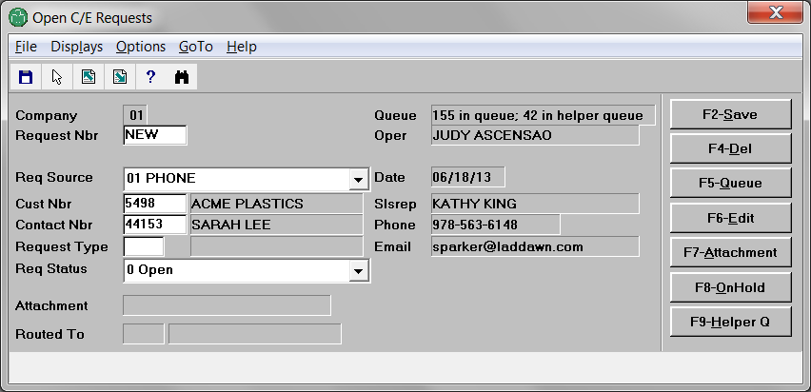
He leaves request source as phone. He enters customer number (Acme). He enters contact (Sarah).

Slide 3
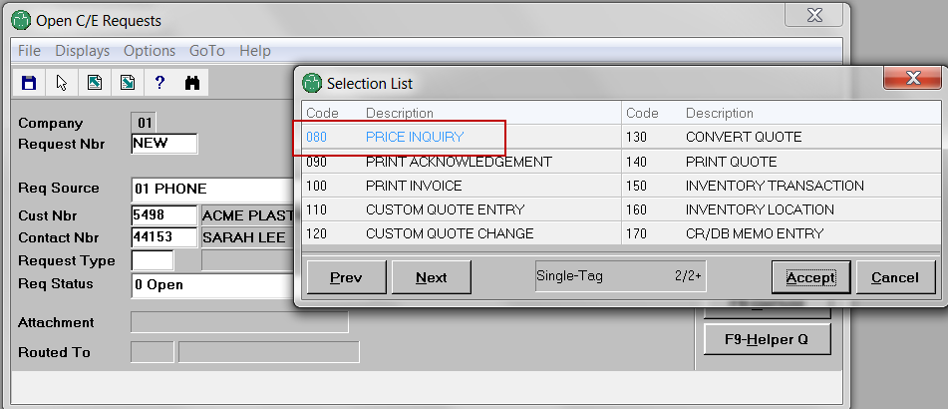
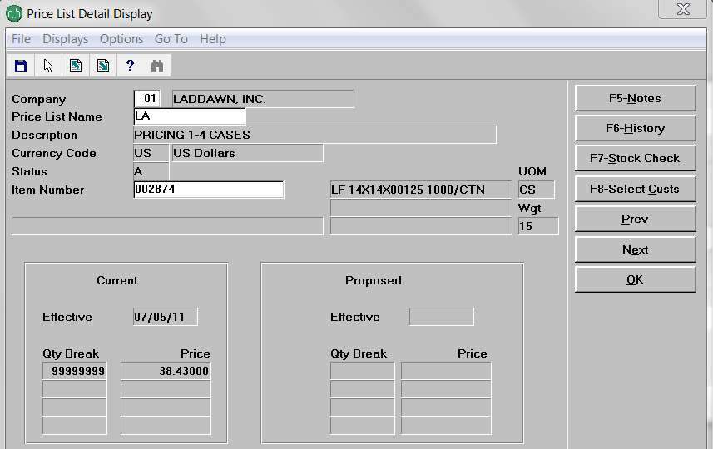
Next, instead of doing this…
F3
And moving to “Price List Detail Display…”

Slide 4

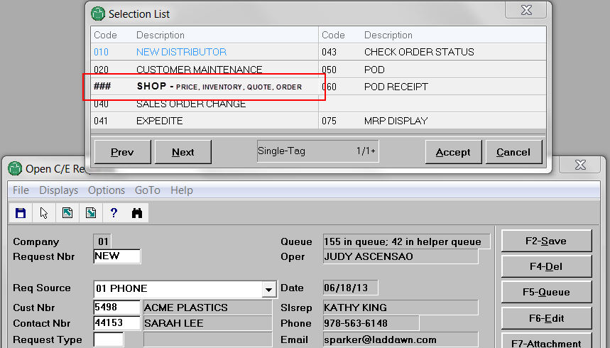
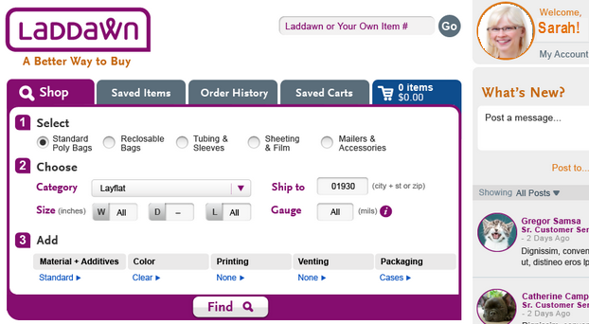

Michael selects new request type that logs him into web as Sarah. He enters item number and zip.
2898
He clicks “Find”

Slide 5
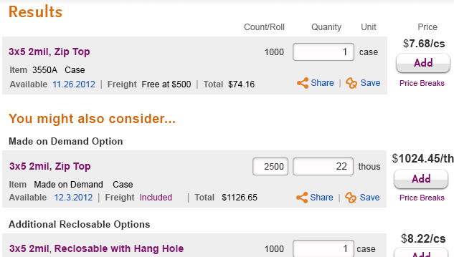
Clicking Find generates results like this (just pretend it’s a 14 x 14 layflat in cases):
This sequence of steps, with slight variations, also works for the following request types…

Slide 6
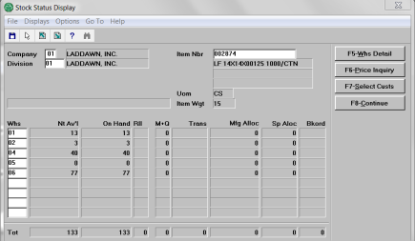
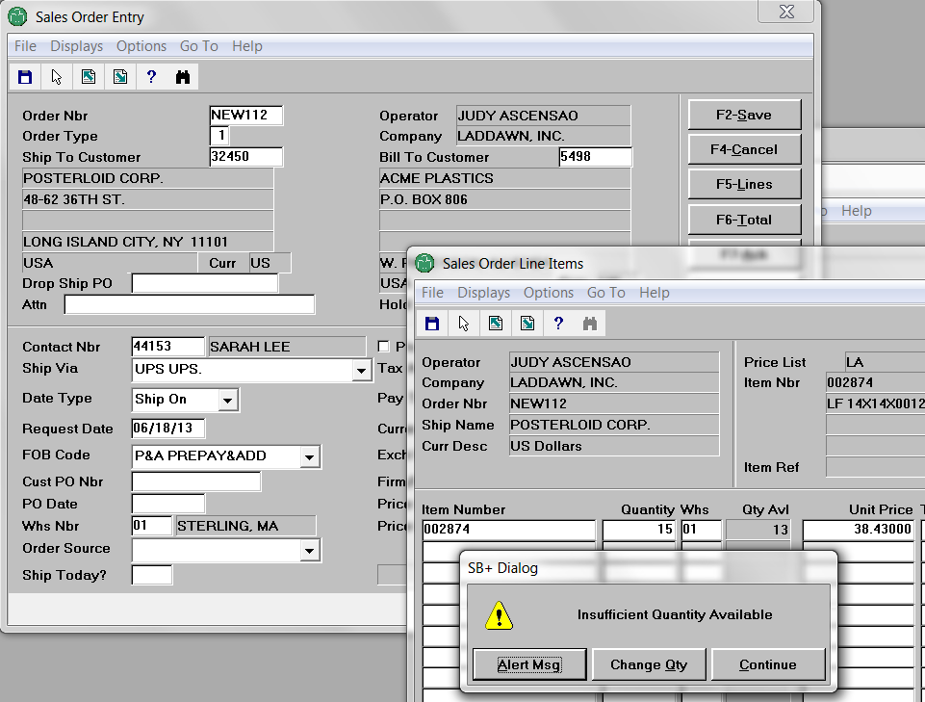
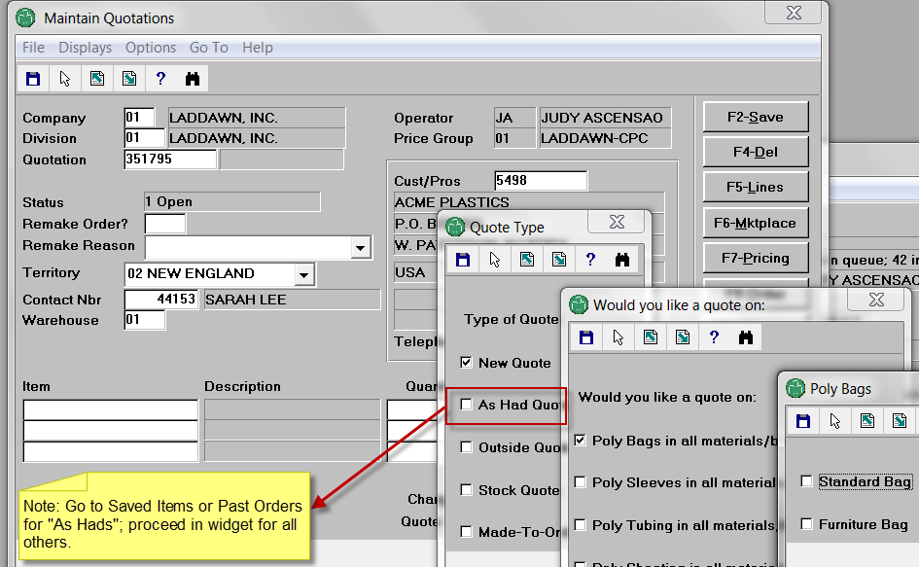
070 – stock check (basic – still need Avante req for advanced functions)
030 – sales order (address insufficient quantity at checkout)
110 – custom quote (and 120 custom quote change)

Slide 7
Conversations can dictate 1-click detours, once Michael is logged in
030 – sales order
130 – convert quote
IIs this a reorder? Go to Order History. Is this something Sarah or someone in her organization recently called about or priced on the web? Go to Saved Items or Saved Carts. (Also scan thread for system msgs?)
In a hurry? No interest in YMAC? Use Cart “Quick Add.”
030 – sales order
070 – stock check
080 – price check
New quote? Fill out shop tab, instead of entering item #. “As had”? Go to Saved Items or Order History. Quote change? Go to Saved Items or Cart.
110– custom quote
120 – custom quote change

Slide 8
Move to the web – as one type or two or more?
030 SALES ORDER ENTRY
070 STOCK CHECK BASIC
080 PRICE INQUIRY BASIC
110 CUSTOM QUOTE ENTRY
120 CUSTOM QUOTE CHANGE
130 CONVERT QUOTE
030? 03X? “SHOP” >
Shop tab
~ 70% of requests
043 CHECK ORDER STATUS
050 PROOF OF DELIVERY
043? 04X? “CHECK ORDER” >
Order History Tab
Keep in Avante
TBD
040 SALES ORDER CHANGE (10%)
041 EXPEDITE
060 POD RECEIPT
070 STOCK CHECK ADVANCED
075 MRP DISPLAY
080 PRICE INQUIRY ADVANCED
160 INVENTORY LOCATION
170 CR/DB MEMO ENTRY
180 CR/DB MEMO CHANGE
190 RA ENTRY
200 RA CHANGE
210 RA INQUIRY
220 RA ACKNOWLEDGMENT
230 GENERAL
090 PRINT ACKNOWLEDGMENT
100 PRINT INVOICE
140 PRINT QUOTE
~ 30 % of requests

