Slide 1
The Experience
Still on the verge of being experienced

Slide 2
Overview
The mechanics of The Experience from the perspective of our customers
Pre Login
Post Login
Laddawn interface – our tool
First Take

Slide 3
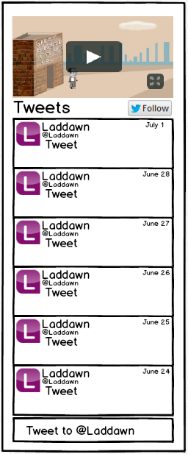
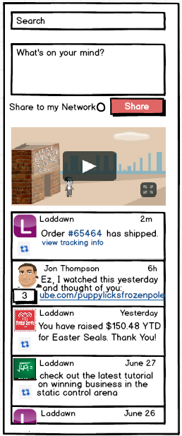
The End User Experience
Pre Login
Post Login
Search
Bulletin
WOYM
Bulletin
Twitter Feed
Laddawn Feed

Slide 4
Overview of Pre-Login Experience
Bulletin:
Auto-rotating carousel
Contains relevant / engaging marketing material
Occupies our single “hero-space”
Twitter Feed
Aggregates Laddawn tweets

Slide 5
Overview of Post Login Experience
Search
Provides a quick and easy tool to locate previous Posts within the Laddawn Feed
WOYM
Text field used to encourage communication between users
400 character limit
Allows the sharing of text and hyperlinks to an individual’s Walled Garden (network)
Provides additional targeted sharing

Slide 6
Overview of Post Login Experience (cont.)
Bulletin
Same as pre-login
Comments on Bulletin topics appear as Posts in a user’s feed and to their Walled Garden
Laddawn Feed
Home for text driven engagement
Comprised of Posts generated by Laddawn systems and content created by the user’s network
Allows for commenting on most content

Slide 7
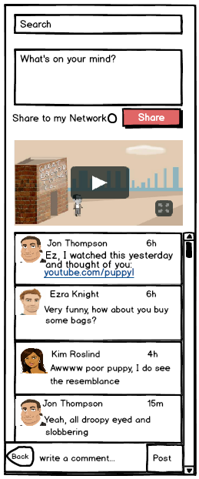
New Comment Functionality
Scenario: Clicking on a Post to add a comment
Updated Post design
Isolates discussion thread
Chronological order
Navigation button
Text field /w Post button

Slide 8
Considerations for Laddawn Users
Need To:
interact across multiple “walled gardens”
Fast & easy searches
ability to see what the customer is seeing
safeguards to prevent accidental sharing
determine who is active & which customers are in need of a response
see & respond to recent activity
not be inundated with minutia or redundant content
streamline and minimize navigation

Slide 9
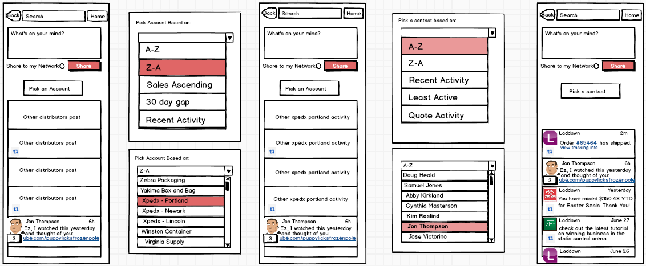
The Laddawn User Experience
Shadow Boxes
This is what Ezra sees when he logs in to Laddawn.com
Next, he filtered out all other walled gardens but Xpedex - Portland
Lastly, he is viewing Jon Thompsons Experience

Slide 10
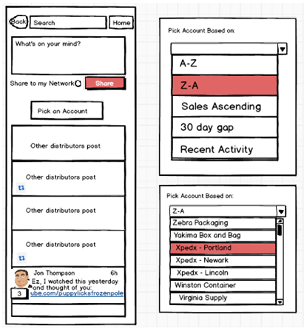
Account Selection

Slide 11
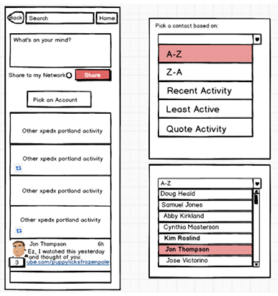
Contact Selection

Slide 12
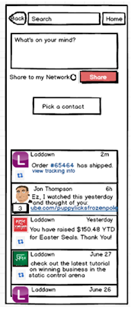
Contact’s Experience

Slide 13
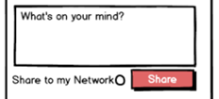
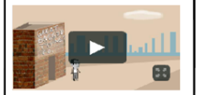
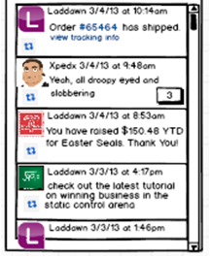
Basics of the Post Login Experience
Search
What's on Your Mind
Bulletin
Feed

Slide 14
Changes
Pre-login
Alternative 2 for the pre-login, Twitter Feed with 1 “hero space”
Feeding the Feed
Nix List
Carts: save, update, delete
Orders: complete, update, created
Credit status
Predictive ordering
Sharing
Put Laddawn rep at the top of the list
Continue to define
How new comment indications are displayed on the Bulletin
Mockup of posts with comments and a comment field
How Search results display
Consider
When thinking about Laddawn UI, Sales types will probably log into the website but CE types won’t. They will log in as customers with “extra options”.
Chalkboard style for the highlight reel videos.
The Laddawnican Experience
When an Inside Sales or CR rep logs into the Experience they are presented with a list of their customers
whether the list is a drop down or some other built in part of the experience is undetermined
This list shows recent posting activity, systems activity, etc through small icons
The list is located where the feed would normally exist
Once a customer is selected from the List the feed populates with content from the customer's feed and the List (of customers) disappears.
There is a HOME button on the feed that will bring the Laddawnican back to the original customer LIST

Slide 15
Search
Search replaces the need for content filtering (buckets)
Allows user to find what they're looking for quickly
Returns results of most recent posts first
Enables searching for specific discussions, carts, orders, tracking etc.

Slide 16
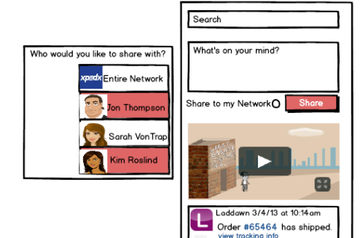
What’s on Your Mind
Sharing functionality

Slide 17
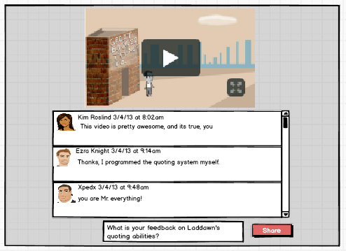
The Bulletin
How to Handle Media Driven Engagement
Shadow Box

Slide 18
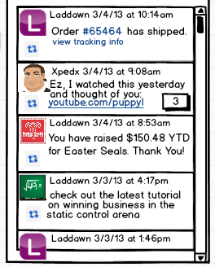
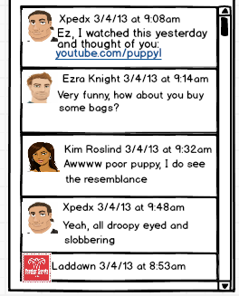
The Feed
How to Handle Text driven engagement
Our Recommendation
Original Post to Chronological Expansion

Slide 19
Feeding the Feed
Cart expiration warning
Order is shipped
RMA status updates
Sharing an Item
Laddawn generated system messages
Price changes*
Service outages*
Customer pickup notification
Charity donation
Contribution tracker
Training games
Customer education - PowerPoints
Laddawn Twitter feed
Social Messaging
* = comment feature disabled

Slide 20
Basics of the Pre Login Experience
What are we trying to accomplish?
“Entice the hell out of people”
Ladd Lavallee
“Get peoples jowls slobbery”
J^2

Slide 21
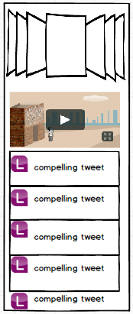
The Experience - Pre Login
Compared to our recommendation, what do we stand to gain or lose from this alternative?
Gain
Lose
Tweets supply real and recent content
A function that users are familiar with
a chance to show off the appeal of post login functionality

