Slide 1
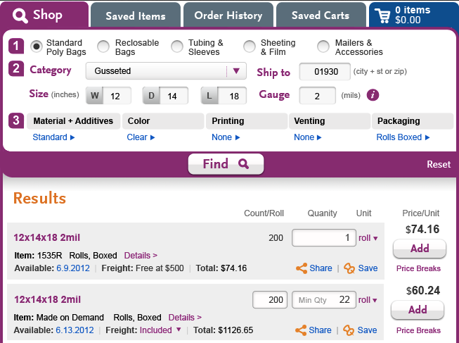
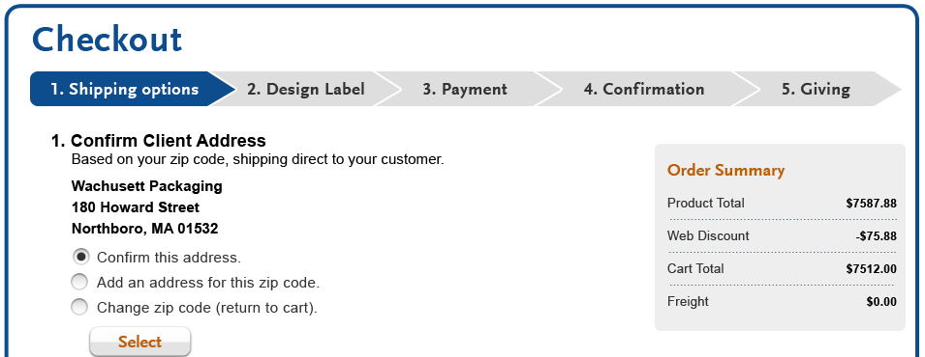
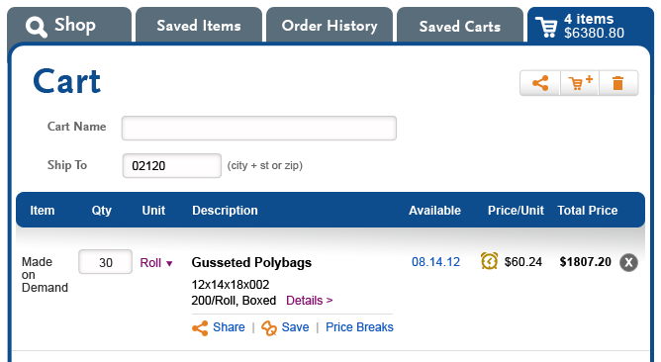
Availability & warehouse -- defaults & options
In Results and Cart ….
Item by item basis
Informational only – no ability to choose options
In Checkout
“Whole cart” basis
Actionable – defaults can be overridden with valid options, on an item by item basis

Slide 2
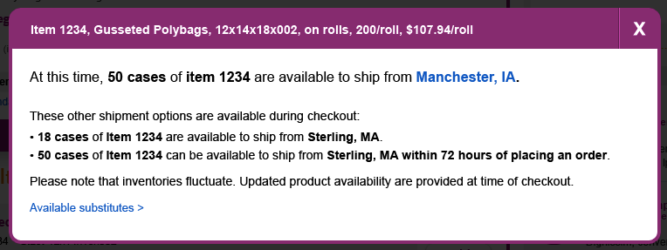
1. Results and Cart
Click on availability date to see warehouse and options (read-only)
When item is available at primary warehouse
When item is short at primary warehouse

Slide 3
2. Checkout
The system will determine warehouse and availability on the basis of all the items in the cart, for optimal bundling of shipments
Bundling defaults
Combine all stock that is available within 72 hours from each warehouse into 1 shipment per warehouse giving it the latest availability date. For example, there are 3 stock items in an order; on an individual basis 2 are available same day from primary warehouse; the third is available from primary in 72 hours. Default is to bundle all three items into a single shipment from primary warehouse within 72 hours.
Create a single shipment for any stock item (purchased) that has a lead time greater than 72 hours.
Create a single shipment for each MOD item using warehouse and availability date derived from configurator - exception, if multiple MODs happen to be shipping same date, same warehouse, default is to bundle those items.
Option to allow stock to ride with MOD will be offered

Slide 4
Checkout
Line Level Overrides
Line items within bundle | Overrides offered
Stock items shipping PW-24 | If MOD item(s) part of same order - ship with earliest available MOD item
Stock items shipping AW-24 (Laddawn-made only, not purchased stock items) | Offer PW-72 (if there happens to be another PW-72 in order, these items would be combined into single shipment bundle) If partial quantity available at PW– ship partial PW-24 and BO rest PW-72 If MOD exists in order - ship with next MOD item
Stock items shipping PW-72 | If partial quantity available at PW– ship partial PW-24 and BO rest PW-72 If MOD exists in order - ship with next MOD item If item is actually available sooner, but PW-72 due to other item in bundle, "Ship this sooner, PW-24" (unbundle)
Stock items shipping MW-72 | If partial quantity available at PW– ship partial PW-24 and BO rest MW-72
Purchased stock items, AW-72 | If partial quantity available at PW– ship partial PW-24 and BO rest PW-LEAD TIME Ship complete from PW with date derived from system based on supply order or purchase lead time

