Slide 1
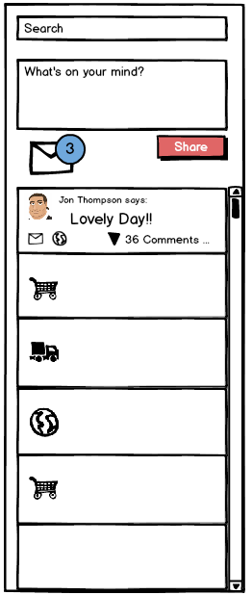

Slide 2
What's on Your Mind

Slide 3
The Mechanics of a Post

Slide 4
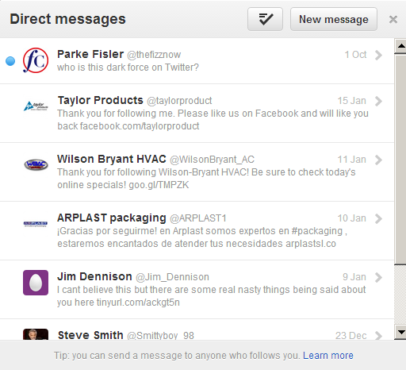
Direct Messaging

Slide 5
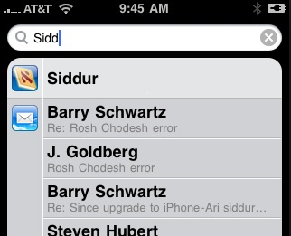
Search

Slide 6
Posting v. Direct Messaging
Posting
Shared to the entire network
Happens through the feed via WOYM
New posts aren't accompanied by notification
Direct Messaging
Targeted to specific individuals or small groups
DM’s segregated from posts, live in the XP inbox
Visual notification of new direct messages

Slide 7
Why Posts AND Direct Messages
Benefits
Posts
Low barrier to entry
Quickly share to entire network
Familiar (fbook/twitter/linkedin have ‘wall’)
Crucial to engagement
Searchable via keyword
Direct Messages
Allow for privacy and confidentiality
Familiar (fbook/twitter/linkedin have ‘inbox’)
Increased visibility and importance via notification
Can’t miss the notification

