Slide 1
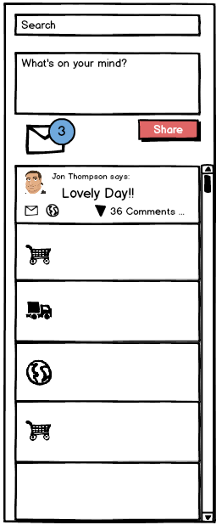

Slide 2
What's on Your Mind
Text field used to encourage communication engagement between users
400 character limit
Allows the sharing of text, videos, images, and hyperlinks to an individual’s Walled Garden (network)
Videos and images shared as thumbnail posts within the feed
Thumbnails that are clicked generate shadow boxes with additional content, including comments
When there are many comments a scroll bar assists in navigating through them
Text and hyperlinks also create posts within the feed
Comments are made and read directly within the feed.
Comments expand downward in chronological order
Provides additional targeted sharing

Slide 3
The Mechanics of a Post
3 types
1. Media posts
Contain images or videos
Comment tallies are displayed on the post
Generate shadow boxes when clicked
Shadow boxes contain comments
When there are many comments a scroll bar assists in navigating through them
2. Text posts
Contain conversational text or hyperlinks
Commenting and replying occurs within the feed

Slide 4
The Mechanics of a Post 2
3. Notification posts
Typically reminders or “activity receipts”
Examples: You have shared a cart with XXXXX, Your cart XXXXX is about to expire, etc.
Some notifications may be direct from Laddawn
Commenting disabled, highlighted / call outs,
Posts usually contain the following information:
Who posted – with avatar
When they posted
# of comments
Ability to re-share??? and direct message from original message – we have no idea what the globe does

Slide 5
Posting v. Direct Messaging
Posting
Shared to the entire network
Happens through the feed via WOYM
New posts aren't accompanied by notification
Direct Messaging
Targeted to specific individuals or small groups
DM’s segregated from posts, live in the XP inbox
Visual notification of new direct messages

Slide 6
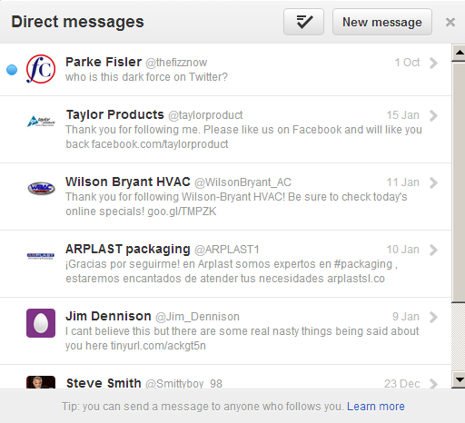
Direct Messaging
Direct Messaging
Targeted to specific individuals or small groups
DM’s segregated from posts, live in the XP inbox
Visual notification of new direct messages
To Do:
Iron out direct messaging interface
Messaging multiple individuals
then responding to the group vs. a single recipient

Slide 7
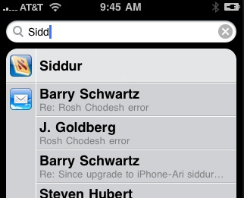
Search
Search provides quick access to any posts within the feed
The search text field searches the contents of posts and returns results in a drop down window. The amount of results shrinks as the searcher continues to enter more data.

Slide 8
Why Posts AND Direct Messages
Benefits
Posts
Low barrier to entry
Quickly share to entire network
Familiar (fbook/twitter/linkedin have ‘wall’)
Crucial to engagement
Searchable via keyword
Direct Messages
Allow for privacy and confidentiality
Familiar (fbook/twitter/linkedin have ‘inbox’)
Increased visibility and importance via notification
Can’t miss the notification

Slide 9
Bulletin
Bulletin
Same as pre-login
Comments on Bulletin topics appear as Posts in a user’s feed and to their Walled Garden

Slide 10
Laddawn Feed
Home for text driven engagement
Comprised of Posts generated by Laddawn systems and content created by the user’s network
Allows for commenting on most content

Slide 11
