Slide 1
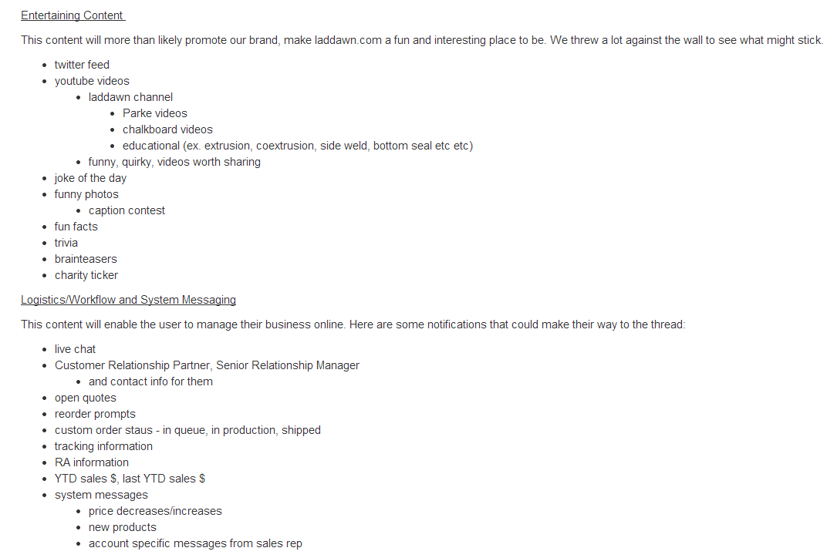

Slide 2
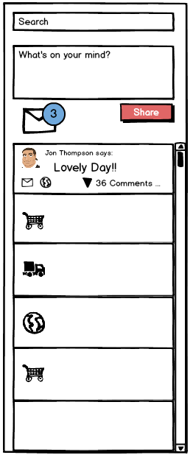

Slide 3
Types of Possible Communication
Direct Messaging
Posting
Targeted
Set apart
Have notification
Network wide
In the feed via WOYM
No notification
Notes:
Media
Text
Responses to system messages

Slide 4
Why Posts AND Direct Messages
Benefits
Posts
Low barrier to entry
Quickly share to entire network
Familiar (fbook/twitter/linkedin have ‘wall’)
Crucial to engagement
Searchable via keyword
Direct Messages
Allow for privacy and confidentiality
Familiar (fbook/twitter/linkedin have ‘inbox’)
Increased visibility and importance via notification
Can’t miss the notification

Slide 5
What Does ‘What's on Your Mind?’ Do?
Drives content to the feed
Encourages engagement
Share text, videos, images, and hyperlinks to an individual’s network
Notes:
400 character limit

Slide 6
What is ‘The Feed’?
Landing area for 3 types of posts
Media
Text
System Notifications
Notes:
with additional content, including comments
When there are many comments a scroll bar assists in navigating through them
Comments are displayed in chronological order
Comments are made and read directly within the feed.
Comments expand downward in chronological order
Text and hyperlinks create posts
Videos and images shared as thumbnails
Clicked thumbnails generate shadow boxes

Slide 7
Feeding the Feed
Mocked up images – include media, text, and notifications
Notes:
Feeding the feed feels like a couple of slides that have the different example posts showcased.
Saving a cart
Sharing a cart*
Updating a cart
Deleting a cart
Cart expiration warning – important*
Order is created
Order is updated
Order is complete
Order is shipped*
Is the order activity redundant?
Sharing an Item
Share button may appear on an item
Sharing requires less "commitment" than sharing a cart with one Item
"I'm a sales guy I don't cut po's"
The buyer has a number of shared items that they can consolidate into a single cart from many sales guys
Laddawn generated system messages***
Price changes*
Service outages*
Customer pickup notification
Charity donation
CHARITY DONATION EXPANDS TO CONTRIBUTION TRACKER Contribution tracker
Customer education - PowerPoints
either DM or feed
Laddawn Twitter feed*
Social Messaging*

Slide 8
The Mechanics of a Post
1. Text Posts
2. Notification Posts
3. Media Posts
Notes:
. Media posts
Contain images or videos
Comment tallies are displayed on the post
Generate shadow boxes when clicked
Shadow boxes contain comments
When there are many comments a scroll bar assists in navigating through them
2. Text posts
Contain conversational text or hyperlinks
These posts are user generated
Commenting and replying occurs within the feed
3. Notification posts
Typically reminders or “activity receipts”
Examples: You have shared a cart with XXXXX, Your cart XXXXX is about to expire, etc.
Some notifications may be direct from Laddawn
Commenting disabled, highlighted / call outs,
Text posts are open ended, notification posts are formulaic
Posts usually contain the following information:
Who posted – with avatar
When they posted
# of comments
Ability to re-share??? and direct message from original message – we have no idea what the globe does

Slide 9
Media Posts – Shadow Box

Slide 10
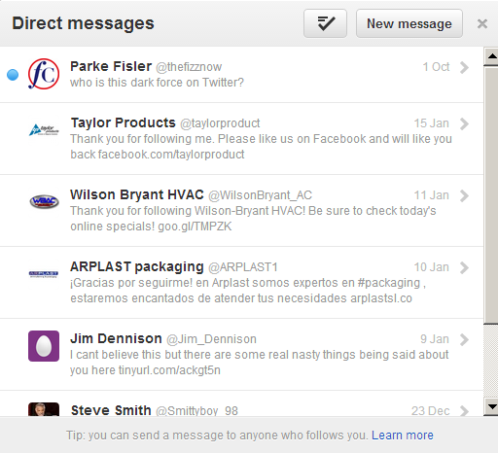
Direct Messaging
Direct Messaging
Targeted to specific individuals or small groups
DM’s segregated from posts, live in the XP inbox
Visual notification of new direct messages
To Do:
Iron out direct messaging interface
Messaging multiple individuals
then responding to the group vs. a single recipient

Slide 11
Decision Point: DMs
Direct Messaging allows communication from:
One person to another person (in their network)
One person to another person (in any network)??
One person to many people??
One person to a single person who was part of a group message??

Slide 12
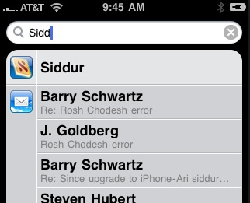
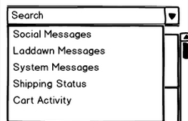
Search
Search provides quick access to any posts within the feed
The search text field searches the contents of posts and Direct Messages and returns results in a drop down window. The amount of results shrinks as the searcher continues to enter more data.

Slide 13
Bulletin
Bulletin
Same as pre-login
Comments on Bulletin topics appear as Posts in a user’s feed and to their Walled Garden

Slide 14
