Slide 1
Image Application Selection

Slide 2
Printing on Laddawn.com
What we want a Laddawn.com user to do with an image?
● Upload the image
● Detect the quality of the image
● Place the image on a correctly scaled bag
● Orient the image
● Manipulate the image
● “Create” a new image
Limited – cannot tell if an image is blurry, but can tell if it is a vector image
Limited – no designer is a drawing program
What we want as “Outputs” once the Laddawn.com user has finished work
● Parameters of the image
Size of the image
Percentage of Coverage
Number of Colors
● A high quality image file suitable for production of a print plate
Identified by sales org and image name
A vector image
An image that makes color separation possible
● Schematic with exact image placement for accurate bag manufacturing
Identified by sales org, image name, and quote number
Yes
Tougher
Tougher

Slide 3
Printing on Laddawn.com
Potential Vendors
Company | Location | Product | Cost
ZenPrint | Utah | ZenStudio
iScripts | Illinois | Printlogic
Qprintpro | Canada (US Office) | E-Designer
PrintNow | Massachusetts | PrintNow
Aleyant | Illinois | eDocBuilder
No-refresh | India (US Office) | Online Designer
DesignNBuy | India (US Office) | All-In-One Designer
Onprintshop | India (US Office) | Online Designer Studio
Amazing Print | Canada | eCardBuilder
Zenprint – Standalone designer that resides on the web that you pay a monthly fee to “call” from you web site. Ultimately, cannot do dynamic templates and not interested in modifying a version for us for a fee.

Slide 4
Printing on Laddawn.com
Potential Vendors
Company | Location | Product | Cost
ZenPrint | Utah | ZenStudio | $299/month
iScripts | Illinois | Printlogic
Qprintpro | Canada (US Office) | E-Designer
PrintNow | Massachusetts | PrintNow
Aleyant | Illinois | eDocBuilder
No-refresh | India (US Office) | Online Designer
DesignNBuy | India (US Office) | All-In-One Designer
Onprintshop | India (US Office) | Online Designer Studio
Amazing Print | Canada | eCardBuilder
iScripts – Designer software in a box. One-time fee, buy the software, load it on our server and away we go. They are willing to modify the software for our use at a “too reasonable” price. After they did more research, they stated their software is built in PHP and because our web site is Asp.net, they are not compatible.

Slide 5
Printing on Laddawn.com
Potential Vendors
Company | Location | Product | Cost
ZenPrint | Utah | ZenStudio | $299/month
iScripts | Illinois | Printlogic | $5,000
Qprintpro | Canada (US Office) | E-Designer
PrintNow | Massachusetts | PrintNow
Aleyant | Illinois | eDocBuilder
No-refresh | India (US Office) | Online Designer
DesignNBuy | India (US Office) | All-In-One Designer
Onprintshop | India (US Office) | Online Designer Studio
Amazingprint.com | Canada | eCardBuilder
Qprintpro – They offer a design only component, which they will customize, although they would rather offer the full package. They are higher priced on the consulting end ($60K-$80K) and doubt they can do the random repeat component. Finally, their designer is built in Flash, which knocks them out.
Bought by Staples July 11th.

Slide 6
Printing on Laddawn.com
Potential Vendors
Company | Location | Product | Cost
ZenPrint | Utah | ZenStudio | $299/month
iScripts | Illinois | Printlogic | $5,000
Qprintpro | Canada (US Office) | E-Designer | $60-$80K + $300/month
PrintNow | Massachusetts | PrintNow
Aleyant | Illinois | eDocBuilder
No-refresh | India (US Office) | Online Designer
DesignNBuy | India (US Office) | All-In-One Designer
Onprintshop | India (US Office) | Online Designer Studio
Amazing Print | Canada | eCardBuilder
PrintNow – They are out of Agawam and are very eager to work with us. Their designer is not standalone and would require significant customization (which they would do), but they doubt they can do the random repeat component. Finally, their monthly fee is significantly higher than everyone else ($1,995/month). Their reasoning is we are using just a fraction of their capability, but we would need to pay the same fee.

Slide 7
Printing on Laddawn.com
Potential Vendors
Company | Location | Product | Cost
ZenPrint | Utah | ZenStudio | $299/month
iScripts | Illinois | Printlogic | $5,000
Qprintpro | Canada (US Office) | E-Designer | $60-$80K + $300/month
PrintNow | Massachusetts | PrintNow | $20K + $1,995/month
Aleyant | Illinois | eDocBuilder
No-refresh | India (US Office) | Online Designer
DesignNBuy | India (US Office) | All-In-One Designer
Onprintshop | India (US Office) | Online Designer Studio
Amazing Print | Canada | eCardBuilder
Aleyant – They offer an end-to-end printing solution and their designer is not standalone. They would pull the designer component out for us, for approximately $12K, but they cannot do dynamic templates.

Slide 8
Printing on Laddawn.com
Potential Vendors
Company | Location | Product | Cost
ZenPrint | Utah | ZenStudio | $299/month
iScripts | Illinois | Printlogic | $5,000
Qprintpro | Canada (US Office) | E-Designer | $60-$80K + $300/month
PrintNow | Massachusetts | PrintNow | $20K + $1,995/month
Aleyant | Illinois | eDocBuilder | $12K + $245/month
No-refresh | India (US Office) | Online Designer
DesignNBuy | India (US Office) | All-In-One Designer
Onprintshop | India (US Office) | Online Designer Studio
Amazing Print | Canada | eCardBuilder
These three companies are all based in India and relatively similar. They all speak OK English, they all really want to work with us, and they are 9 hours ahead, but will overlap a few hours everyday.
No-refresh – They are PHP, so they don’t work with Asp.net, but they want to convert.
DesignNBuy – One-time fee, loaded on our server, no monthly subscription
Onprintshop – Same as DesignNBuy – One-time fee, loaded on our server, no monthly costs

Slide 9
Printing on Laddawn.com
Potential Vendors
Company | Location | Product | Cost
ZenPrint | Utah | ZenStudio | $299/month
iScripts | Illinois | Printlogic | $5K
Qprintpro | Canada (US Office) | E-Designer | $60-$80K + $300/month
PrintNow | Massachusetts | PrintNow | $20K + $1,995/month
Aleyant | Illinois | eDocBuilder | $12K + $245/month
No-refresh | India (US Office) | Online Designer | $1K + $245/month
DesignNBuy | India (US Office) | All-In-One Designer | $7K + consulting
Onprintshop | India (US Office) | Online Designer Studio | $6K + consulting
Amazing Print | Canada | eCardBuilder | $3K + $200/month
Amazing Print – The most promising partner. They offer their designer as a standalone product and have already built the dynamic template generation component. During our conversations and after sharing of the Powerpoint presentation it became obvious our main contact completely understood what we are trying to do. They also view the random repeat component as doable and have discussed customizing the whole pop-up designer display in our design, so there will be no speed issues. Finally, they are reasonably priced and even though the “cloud” would house the designer software, we would have the option to store the images on our servers.

Slide 10
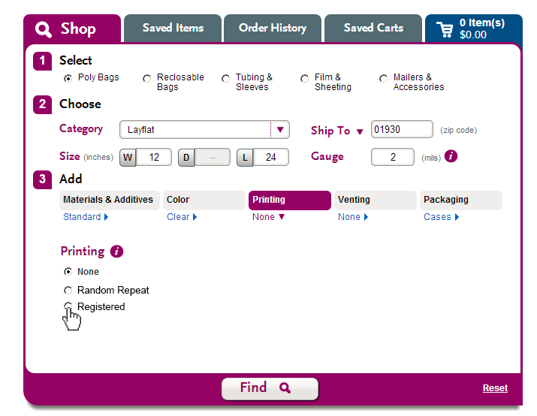
Printing on Laddawn.com
Current Random Repeat Printing Screen
Screen Shot 1
Customer enters length
Customer enters width
To move forward with printing the customer clicks on “None” to expand

Slide 11
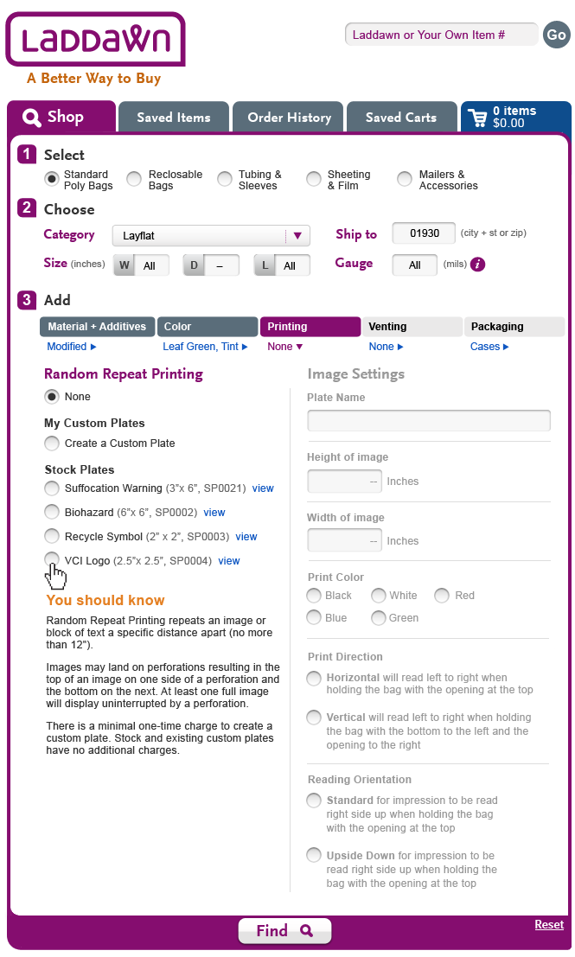
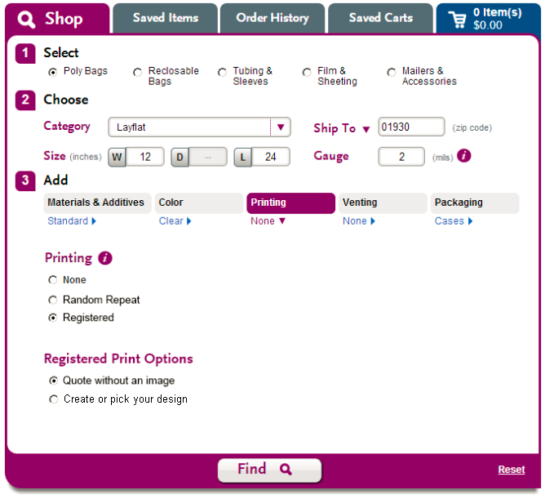
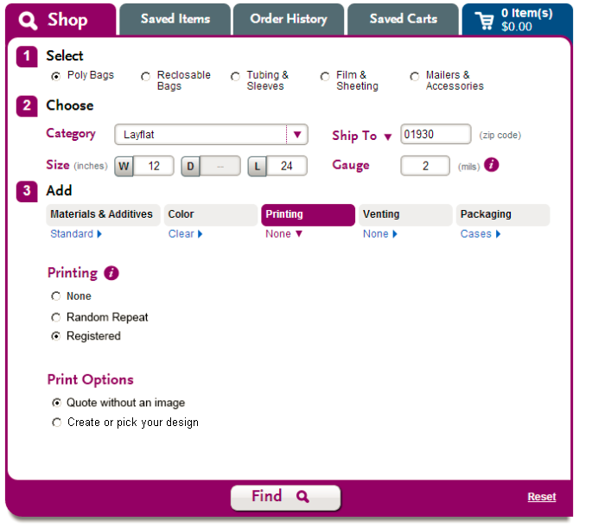
Printing on Laddawn.com
Current Random Repeat Printing Screen
Screen Shot 2
Click on either radio button:
(a flag/variable is set for type of printing)
Displays this:

Slide 12
Quote without an Image

Slide 13
Printing on Laddawn.com
Flowchart
Continue
Printed?
Bag Dimensions Entered
No
Yes
Quote with an image?
Continue
Yes
Enter On-line Designer
No
?
?
Enter On-line Designer
Continue
Print
Summary Screen
Results / Pricing

Slide 14
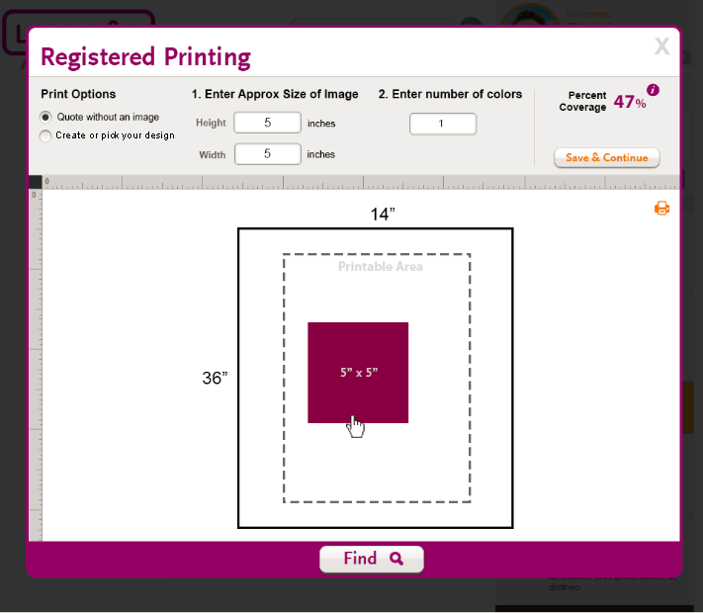
Printing on Laddawn.com
When Registered Printing is checked in previous screens
Third-Party Image Editor when “Quote without an Image” clicked

Slide 15
Printing on Laddawn.com
When Registered Printing is checked in previous screens
Pop-Up
Layer
Third-Party Image Editor when “Quote without an Image” clicked
User
Entered
Ruler
scaled for
bag
dimensions
Other than image size the only manipulation is the moving of the image box when quoting without an image
Bag template scaled from
variables passed from screen 1
After I click “Continue” nothing is saved. Price is calculated based on bag size and user entered fields.
Sized from above

Slide 16
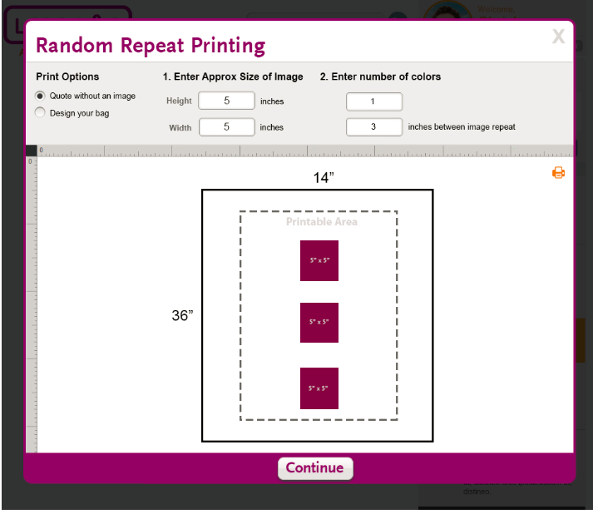
Printing on Laddawn.com
When Random Repeat Printing is checked in previous screens
Third-Party Image Editor when “Quote without an Image” clicked

Slide 17
Printing on Laddawn.com
When Random Repeat Printing is checked in previous screens
Pop-Up
Layer
Third-Party Image Editor when “Quote without an Image” clicked
User
Entered
Ruler
scaled for
bag
dimensions
Spacing sized from above
Other than image size the only manipulation is the moving of the image box when quoting without an image
Bag template scaled from
variables passed from screen 1
After I click “Continue” nothing is saved. Price is calculated based on bag size and user entered fields.
Images Sized from above

Slide 18
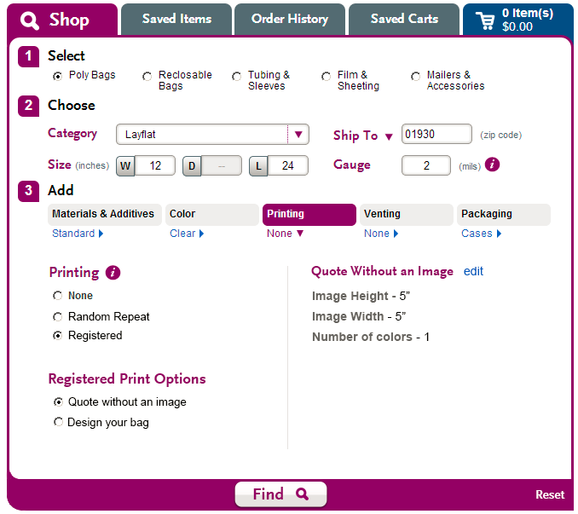
Printing on Laddawn.com
Current Random Repeat Printing Screen
Screen Shot
Click “Edit” to go back to the image editor and change height, width, # colors, and repeat inches of the image
This screen is the same regardless of which radio button is triggered from the previous screens
Only shows when Random Repeat radio button clicked
Inches between image repeats - 3
Click “Find” to get the quote

Slide 19
Printing on Laddawn.com
Current Random Repeat Printing Screen
Screen Shot
User Entered and Modifiable
This screen is the same regardless of which radio button is triggered from the previous screens
Only shows when Random Repeat radio button clicked
Inches between image repeats - 3
Click “Find” to get the quote

Slide 20
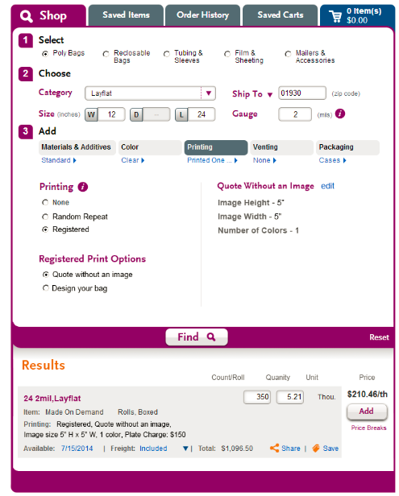
Printing on Laddawn.com
Current Random Repeat Printing Screen
Screen Shot
Clicking “Add” brings the customer to checkout and at that time they are sent back into the image editor as if the clicked on “Create or pick your design”
This screen is the same regardless of which radio button is triggered from the previous screens
Clicking “Share” or “Save” puts the quote in the customer’s “Saved Items” list, which can be added to checkout at any time in the future

Slide 21
Quote with an Image

Slide 22
Printing on Laddawn.com
Current Random Repeat Printing Screen
Screen Shot 2
Click on either radio button:
(a flag/variable is set for type of printing)
Displays this:

Slide 23
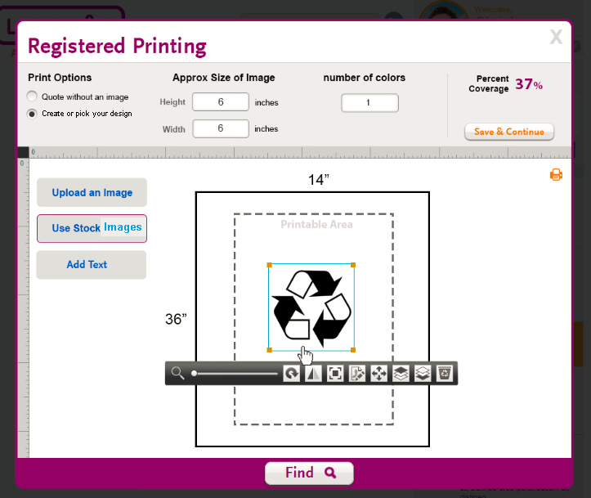
Printing on Laddawn.com
When Registered Printing is checked in previous screens
Third-Party Image Editor when “Create or pick your design” clicked
1

Slide 24
Printing on Laddawn.com
When Registered Printing is checked in previous screens
Pop-Up
Layer
Third-Party Image Editor when “Create or pick your design” clicked
Automatic, but can be overridden by the user
Automatically
Calculated
1
Ruler
scaled for
bag
dimensions
Bag template scaled from
variables passed from screen 1
After I click “Continue” image and layout are saved. Price is calculated based on bag size and image parameters.
Representative of third-party image editor toolbars

Slide 25
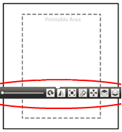
Printing on Laddawn.com
When Random Repeat Printing is checked in previous screens
Third-Party Image Editor when “Create or pick your design” clicked
1

Slide 26
Printing on Laddawn.com
When Random Repeat Printing is checked in previous screens
Pop-Up
Layer
Third-Party Image Editor when “Create or pick your design” clicked
Automatic, but can be overridden by the user
Automatically
Calculated
1
Ruler
scaled for
bag
dimensions
User Entered
Bag template scaled from
variables passed from screen 1
After I click “Continue” image and layout are saved. Price is calculated based on bag size and image parameters.
Representative of third-party image editor toolbars
Spacing sized from above

Slide 27
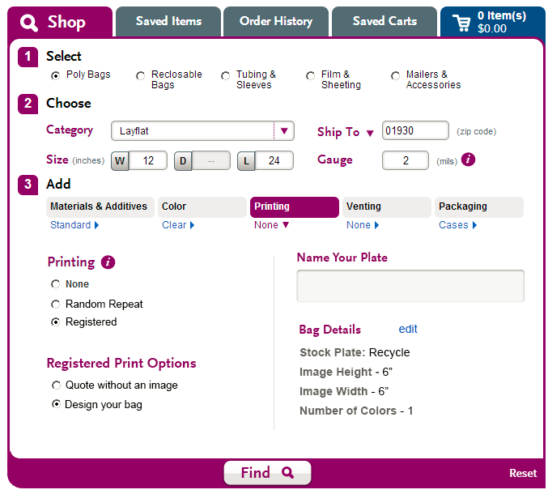
Printing on Laddawn.com
Screen Shot
(After “Continue” is clicked and an image is edited or created)
This screen is the same regardless of which radio button is triggered from the previous screens
Required field
Clicking “edit” sends you back to the image editor

Slide 28
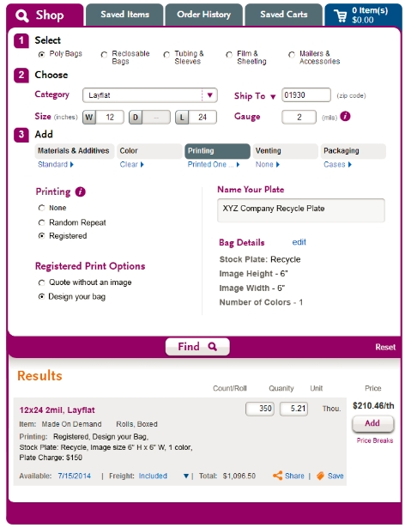
Printing on Laddawn.com
Current Random Repeat Printing Screen
Future Site: Screen 5
This screen is the same regardless of which radio button is triggered from the previous screens
Clicking “edit” sends you back to the image editor
Clicking “Share” or “Save” puts the bag with the image in the customer’s “Saved Items” list, which can be added to checkout at any time in the future
Clicking “Add” puts the bag with the image in the shopping cart and allows the customer to begin the checkout process

