Slide 1
The Experience
On the verge of being experienced

Slide 2
Overview
Back to the drawing board
Took into account feedback from last meeting and made necessary adjustments
Engagement
Pre Login Mock Up

Slide 3
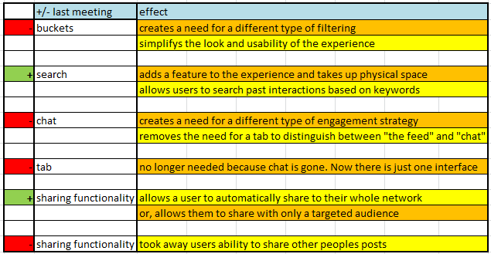
Feedback from last meeting

Slide 4
Pre Login
Website Highlight Reel
Not a tutorial, instead, compelling reasons to get logged in
Bulletin
Comments disabled
Different Strokes
Showcase the post login experience
Twitter feed
Extended bulletin in Experience form

Slide 5
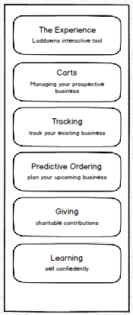
Stroke 1
Highlight Reel Heaven

Slide 6
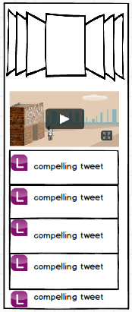
Stroke 2
Twitter Feed

Slide 7
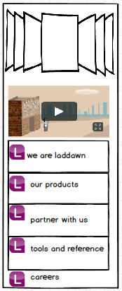
Stroke 3
Static content in the form of the Experience

Slide 8
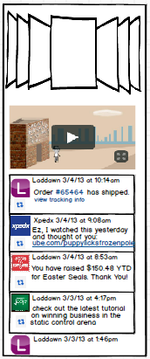
Stroke 4
Showcase the Post Login Experience
Highlight reel
Bulletin
No comments
Model posts showing a broad range of possible interactions

Slide 9
Post Login Engagement
Search
What's on Your Mind
Bulletin
Feed

Slide 10
Search
Search replaces the need for content filtering (buckets)
Searches content of post body
Returns results of most recent posts first
Enables searching for specific discussions, order content, etc.

Slide 11
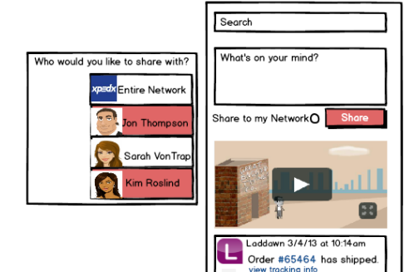
What’s on Your Mind
Sharing functionality

Slide 12
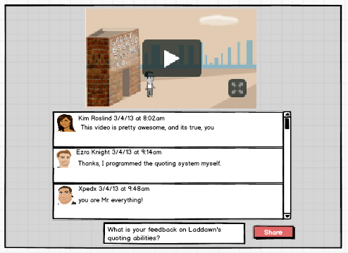
How to handle media driven engagement
Shadow Box

Slide 13
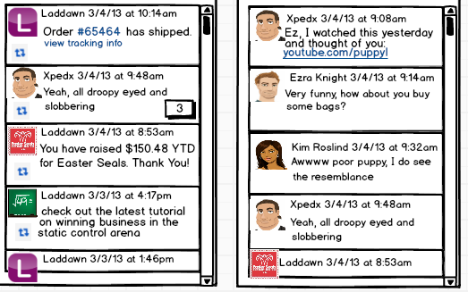
Feed – How to Handle Text driven engagement
Stroke 1 – Most Recent to Chronological Order Expansion

Slide 14
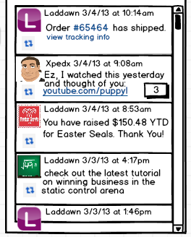
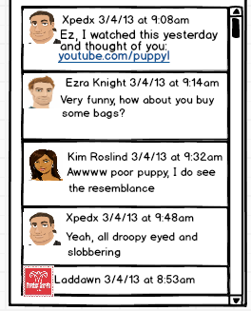
Feed – How to Handle Text driven engagement
Stroke 2 – Original Post to Chronological Expansion

Slide 15
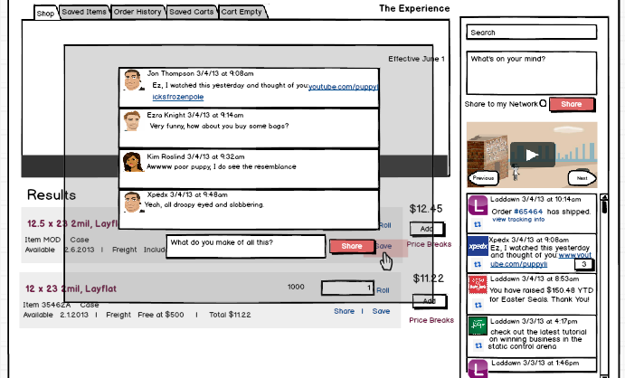
Feed – How to Handle Text Driven Engagement
Stroke 3 – Shadow Box

Slide 16
Feeding the Feed
Saving a cart
Sharing a cart
Updating a cart
Deleting a cart
Cart expiration warning
Order is created
Order is updated
Order is complete
Order is shipped
RMA status updates
Credit status changes
Predictive Ordering Reminders
Sharing an Item
Laddawn generated system messages
Price changes*
Service outages*
Customer pickup notification
Charity donation
Contribution tracker
Training games
Customer education - PowerPoints
Laddawn Twitter feed
Social Messaging
* = comment feature disabled

Slide 17
Questions
Can we piggy back the “walls” based off of existing contact structure?

Slide 18
What are the next steps
Make final adjustments to existing mock ups
Conceptualize and mock up how Laddawnicans will use the Experience

