Slide 1
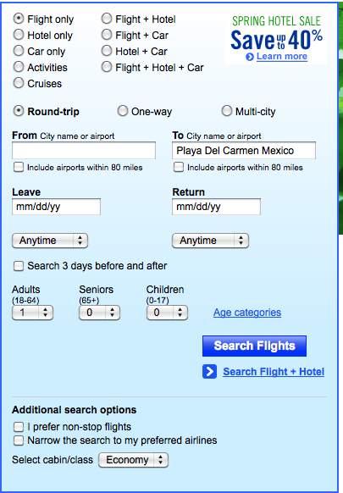
Travel site model
9 (!) radio button choices
when selected, widget reloads, with appropriate subset of search parameters
Why will this work, or not, for Laddawn??
When choices are not valid, do they get grayed out or simply go away? On travel sites they go away; on Laddawn you may want to keep them (grayed out) as a reminder that these choices exist for other product types

Slide 2
By item type:
By item number:
Spring Closeouts!
Bags
Reclosables
Sleeves
Yours or Laddawn’s
Tubing
Palletizing Products
[Marketplace]
Sheeting
Shipping Room
[Marketplace]
Category
Layflat |
Additional Options
Packaging
Rolls |
|
Size
Sizing
Tool
|
Gauge
|
Quantity
Ship to zip code
|
01434
5614
|
Find >
1. Default State

Slide 3
By item type:
By item number:
Spring Closeouts!
Bags
Reclosables
Sleeves
Yours or Laddawn’s
Tubing
Palletizing Products
[Marketplace]
Sheeting
Shipping Room
[Marketplace]
Find >
2. User selects another option, choices below refresh

Slide 4
By item type:
By item number:
Spring Closeouts!
Bags
Reclosables
Sleeves
Yours or Laddawn’s
Tubing
Palletizing Products
[Marketplace]
Sheeting
Shipping Room
[Marketplace]
Category
Pallet Top Covers |
Additional Options
Packaging
n/a
|
Size
Sizing
Tool
|
Gauge
n/a
|
Quantity
Ship to zip code
|
01434
5614
|
Find >
3. Choices now reflect those associated with Palletizing Products

Slide 5
By item type:
By item number:
Spring Closeouts!
Bags
Reclosables
Sleeves
Yours or Laddawn’s
Tubing
Palletizing Products
[Marketplace]
Sheeting
Shipping Room
[Marketplace]
Find >
4. User selects search by item number, screen below refreshes

Slide 6
By item type:
By item number:
Bags
Reclosables
Sleeves
Yours or Laddawn’s
Tubing
Palletizing Products
[Marketplace]
Sheeting
Shipping Room
[Marketplace]
Item number
Yours or Laddawn’s
Quantity
Spring Closeouts!
Learn more >>
1
Ship to zip code
01434
5614
Find >
5. Choices now reflect the narrowed down choices associated with stock item #; excess real estate balanced out with promotional message

