Slide 1
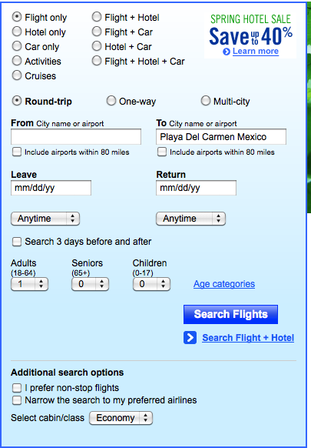
Travel site model
9 (!) radio button choices
when selected, widget reloads, with appropriate subset of search parameters
Why will this work, or not, for Laddawn??
When choices are not valid, do they get grayed out or simply go away? On travel sites they go away; on Laddawn you may want to keep them (grayed out) as a reminder that these choices exist for other product types

Slide 2
By item number:
By item type:
Bags
Reclosables
Sleeves
Yours or Laddawn’s
Tubing
Palletizing Products
[Marketplace]
Sheeting
Shipping Room
[Marketplace]
Ship to zip code:
Additional Options
01434
5614
Category
N/A
N/A
Packaging
N/A
N/A
Size
N/A
Sizing
Tool
N/A
Gauge
N/A
Quantity
1
Find >
1. Default state, search by item number, only other actionable items are zip and quantity. User can override defaults (or not) and hit return or click “Find” to generate results

Slide 3
By item number:
By item type:
Bags
Reclosables
Sleeves
Yours or Laddawn’s
Tubing
Palletizing Products
[Marketplace]
Sheeting
Shipping Room
[Marketplace]
Find >
2. User decides to search by item type; selects “Palletizing Products”; choices begin to refresh.

Slide 4
By item number:
By item type:
Bags
Reclosables
Sleeves
Yours or Laddawn’s
Tubing
Palletizing Products
[Marketplace]
Sheeting
Shipping Room
[Marketplace]
Ship to zip code
01434
5614
Additional Options
Category
Pallet Top Covers |
Vanilla
Packaging
Cold
N/A
Size
Classical
Sizing
Tool
N/A
Gauge
East
Quantity
1
Find >
3. Actionable choices change to those that are relevant to Palletizing Products.

