Slide 1
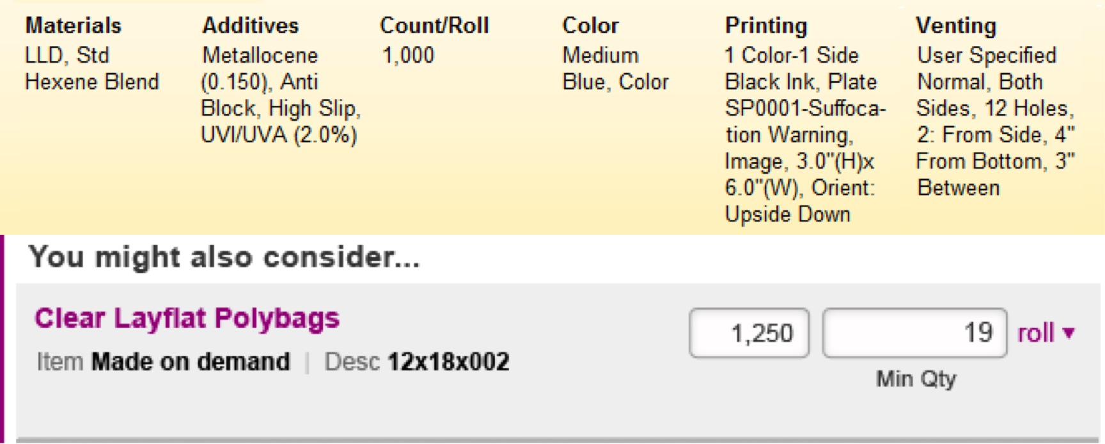
Medium Blue Layflat Polybags
Item Made on demand | Size 12x18x002
Materials LLD, Std Hexene Blend See more

Slide 2
Medium Blue Layflat Polybags
Item Made on demand | Size 12x18x002
Materials LLD, Std Hexene Blend See less
Additives Metallocene (0.150), Anti Block, High Slip, UVI/UVA (2.0%)
Printing 1 Color-1 Side Black Ink, Plate SP0001-Suffocation Warning, Image, 3.0” (H)x6.0”(W), Orient: Upside Down
Venting User Specified Normal, Sides, 12 Holes, 2” From Side, 4” From Bottom, 3” Between

Slide 3
Medium Blue Layflat Polybags
Item Made on demand | Size 12x18x002
Materials LLD, Std Hexene Blend | Additives Metallocene (0.150), Anti Block, High Slip, UVI/UVA (2.0%) | Printing 1 Color-1 Side Black Ink, Plate SP0001-Suffocation Warning, Image, 3.0” (H)x6.0”(W), Orient: Upside Down |Venting User Specified Normal, Sides, 12 Holes, 2: From Side, 4” From Bottom,3” Between
See less

Slide 4
Medium Blue Layflat Polybags
Item Made on demand | Size 12x18x002 See less
LLD, Std Hexene Blend | Metallocene (0.150), Anti Block, High Slip, UVI/UVA (2.0%)
| 1 Color-1 Side Black Ink, Plate SP0001-Suffocation Warning, Image, 3.0” (H)x6.0” (W), Orient: Upside Down | User Specified Normal, Sides, 12 Holes, 2” From Side, 4” From Bottom, 3” Between

Slide 5
Medium Blue Layflat Polybags
Item Made on demand | Size 12x18x002
Materials LLD, Std Hexene Blend See more
X
Medium Blue Layflat Polybags
Item Made on demand | Size 12x18x002
Materials LLD, Std Hexene Blend See less
Additives Metallocene (0.150), Anti Block, High Slip, UVI/UVA (2.0%)
Printing 1 Color-1 Side Black Ink, Plate SP0001-Suffocation Warning, Image, 3.0” (H)x6.0”(W), Orient: Upside Down
Venting User Specified Normal, Sides, 12 Holes, 2” From Side, 4” From Bottom, 3” Between

