Slide 1
STOCK ITEMS
 | Shipping on 2/21/12 from Iowa Hold and ship with Made on Demand items shipping 3/4/12? (i)
Qty | Item | Description | Wt | Total Price | Shipping via | XXXX
8 | 12345 |  |  | $103.00 | Shipping paid by | XXXX
2 | 67890 |  |  | $ 51.60 | Shipping instructions > ----------
MADE ON DEMAND ITEMS
 | Shipping on 3/4/12 from Iowa Hold and ship with Made on Demand items shipping 3/7/12? (i)
Qty | Item | Description | Wt | Total Price | Shipping via | XXXX
50 | Made on demand | Custom product A | 16 | $2,700.00 | Shipping paid by | XXXX
 |  |  |  |  | Shipping instructions > ----------
 | Shipping on 3/7/12 from Iowa
Qty | Item | Description | Wt | Total Price | Shipping via | XXXX
100 | Made on demand | Marketplace product B | 10 | $5,000.00 | Shipping paid by | XXXX
 |  |  |  |  | Shipping instructions > ----------

Slide 2
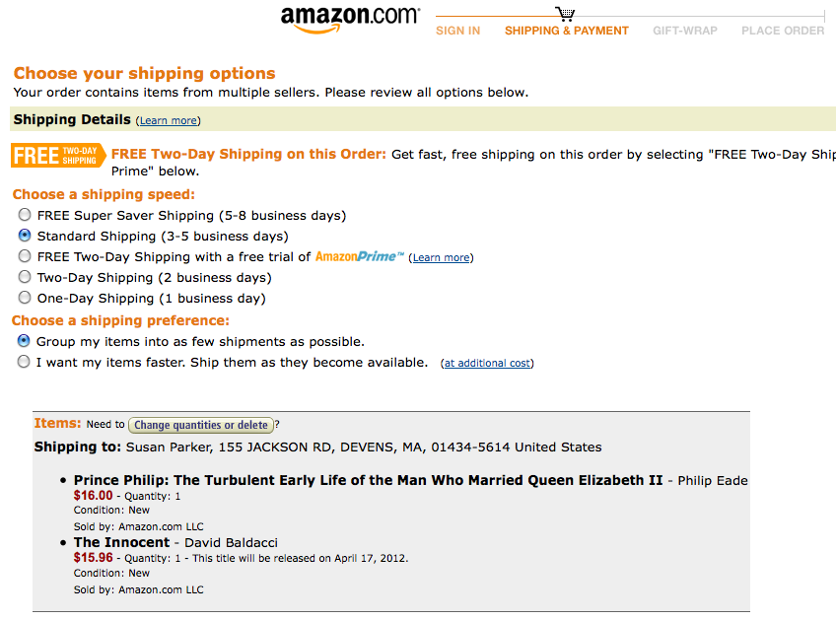

Slide 3
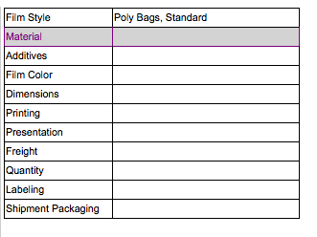
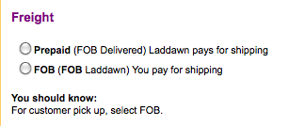
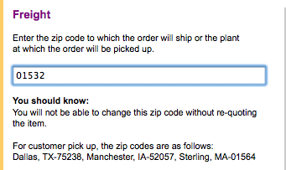
MOD freight options – now part of search results and active cart.

Slide 4
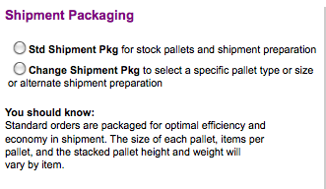
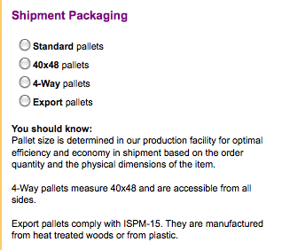
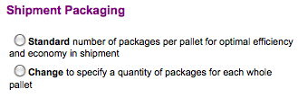

Slide 5

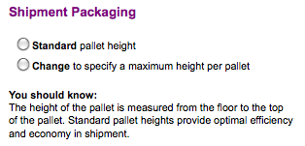
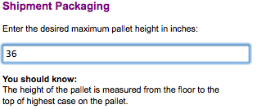
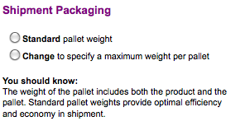

Slide 6
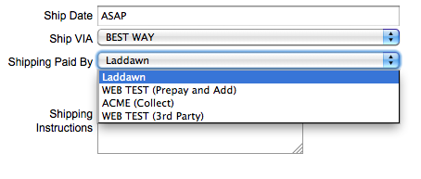
Stock

Slide 7
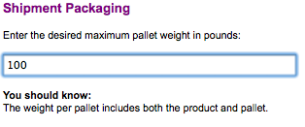
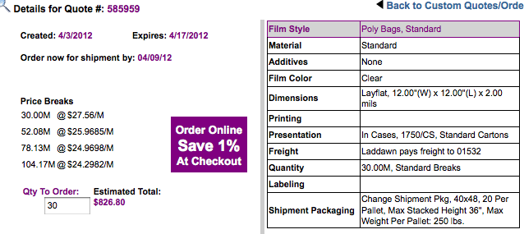

Slide 8
X
Are you sure you want to delete this cart?
Yes
No
X
Would you like to save the current cart first?
Yes
Enter a name
No
Go >

