Slide 1
Product Finding
Kickoff – February 28, 2019

Slide 2
Agenda
Principles of engagement
Method - Design Thinking
Empathize & Define
Current “widget” and search bar
Evaluate and determine next steps

Slide 3
Agenda
Principles of engagement
Method - Design Thinking
Empathize & Define
Current “widget” and search bar
Evaluate and determine next steps

Slide 4
Principles of engagement
Respect, inclusion, transparency throughout project(s)
Rules of brainstorming in this and other meetings
And a little later on…. “The P-Rules” – rules for presentations in future meetings

Slide 5
Rules of Brainstorming
There are no dumb ideas. Period. It is a brainstorming session, not a serious matter that requires only serious solutions.
Don’t criticize other people’s ideas. This is not a debate, discussion or forum for one person to display superiority over another.
Build on other people’s ideas. Often an idea suggested by one person can trigger a bigger or better idea by another person. This building of ideas leads to out-of-the-box thinking.
Reverse the thought of “quality over quantity.” Here we want quantity; the more creative ideas the better.

Slide 6
Agenda
Principles of engagement
Method - Design Thinking
Empathize & Define
Current “widget” and search bar
Evaluate and determine next steps

Slide 7
2. Method – Design Thinking

Slide 8
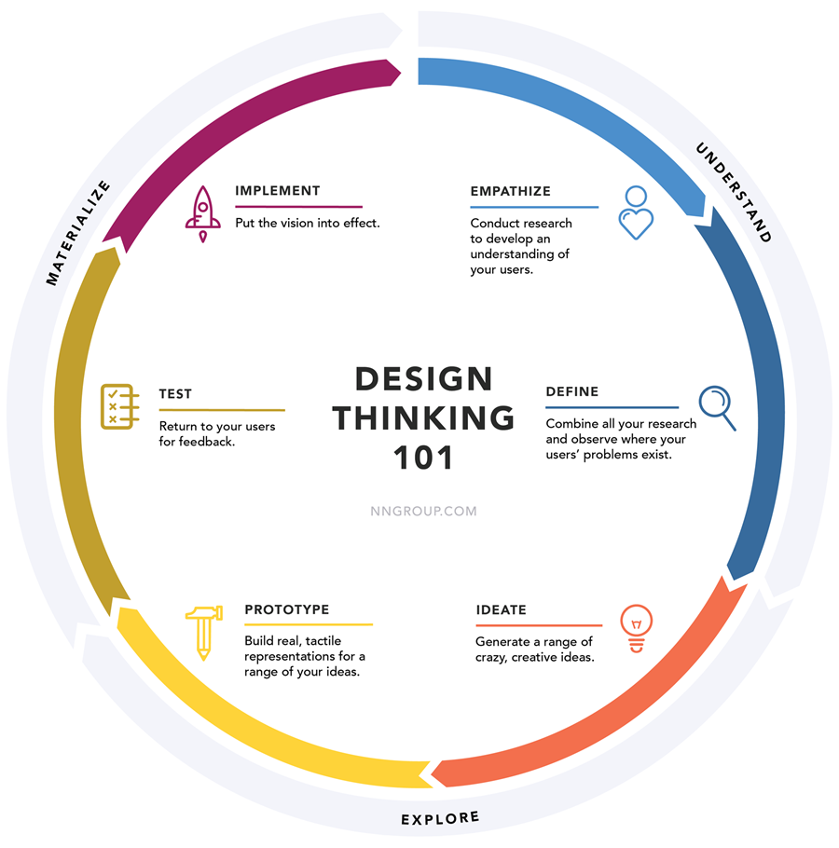
2. Method – Design Thinking
Understand
Empathize
Define
Explore
Ideate
Prototype
Materialize
Test
Implement
Source: Nielsen Norman Group

Slide 9
2. Method – What’s in it for Laddawn?
Ensures we are all working toward the same goals and judging designs by the same objective criteria
Addresses real, not imaginary user needs
Ensures solutions actually achieve goals – increase sales and profit.
Be more “directionally correct” with each release
Establishes a shared language and buy-in within the team
Encourages innovation by exploring multiple avenues
Increases competitive advantage

Slide 10
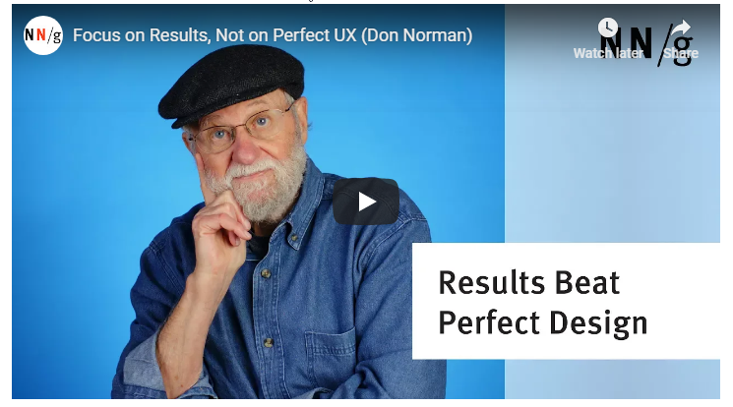
2. Method – one last thought
Focus on results, not perfect design

Slide 11
Agenda
Principles of engagement
Method - Design Thinking
Empathize & Define
Current “widget” and search bar
Evaluate and determine next steps

Slide 12
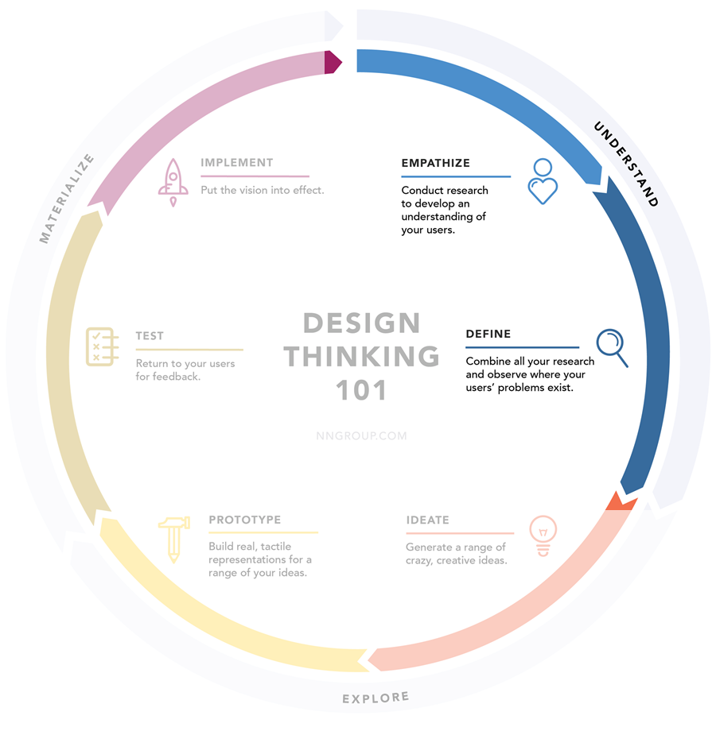
3. Empathize & Define – and we’re off!

Slide 13
3. Empathize & Define
Who are our users?
Humanize them. Think about real people in real roles. We have personas. Are they still representative?

Slide 14
3. Empathize & Define
What are their problems, tasks, intentions and goals? What do they need to accomplish with our Product Finding tools?
What environment(s) do they operate in?

Slide 15
3. Empathize & Define
What is our business’s overarching goal?
[DISCUSS]

Slide 16
3. Empathize & Define
What do our Product Finding tools need to help us accomplish?
Consider …
Berry acquisition
Business climate
Near term v. long term What must we accomplish quickly? What do we have more time to work on? [BRAINSTORM]

Slide 17
Agenda
Principles of engagement
Method - Design Thinking
Empathize & Define
Current “widget” and search bar
Evaluate and determine next steps

Slide 18
3. Current “widget” and search bar
What were the original underpinnings? Do they still hold up? [BRAINSTORM]
After four years, what works and what doesn’t? (Distilled likes/dislikes feedback – plus anything anyone wants to add...) [BRAINSTORM]
Don’t throw the baby out with the bathwater.

Slide 19
Agenda
Principles of engagement
Method - Design Thinking
Current “widget” and search bar
Empathize & Define
Evaluate and determine next steps

Slide 20
5. Evaluate and determine next steps
Evaluate what we’ve said
What conclusions can we draw?
What are the gaps?
Do the preceding brainstorming exercises suggest a scope and timeline for a Product Finding project or projects…
Changes on the increment?
Major overhaul – think outside the widget?
Both of the above, in parallel?
Do we need to do further due diligence to answer this question?

Slide 21
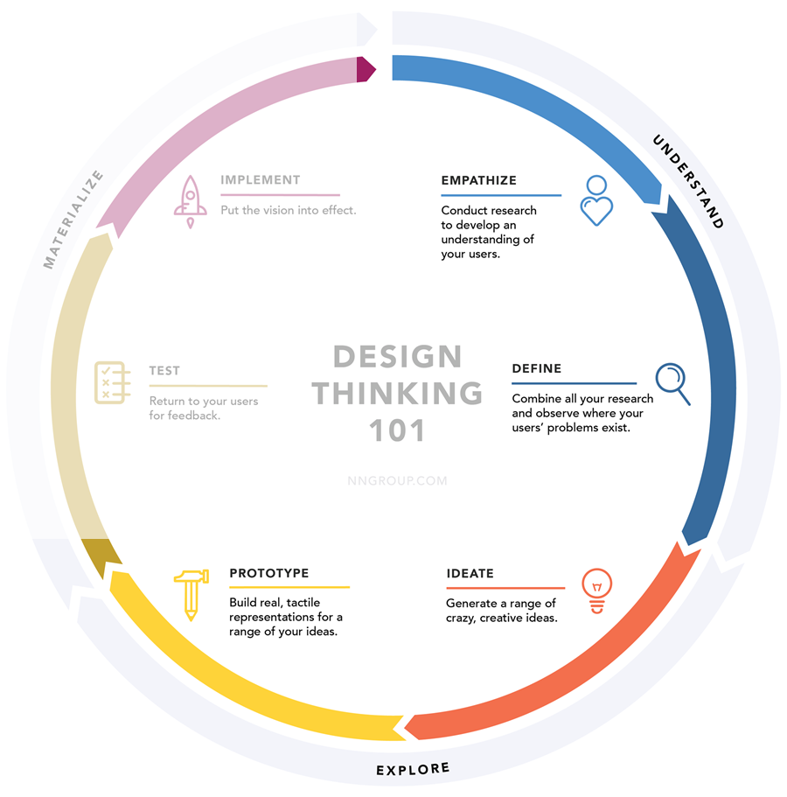
5. Evaluate and determine next steps
Next steps
Distill brainstorming notes further?
More due diligence on context of use/requirements?
Susan and Jeff to visit customers
Usage metrics on current search strategies
Refine personas
In parallel, are there some things we can ideate/prototype now?
What else needs to happen, based on evaluating what we’ve said?
More work?
Start now?

Slide 22
5. Next steps, ideation and prototyping
What’s this?

Slide 23
5. Next steps, ideation and prototyping
Jeff and Susan to lead
Small group sessions, held frequently
Reconvene with larger group regularly and calibrate.
Follow the P-Rules…

Slide 24
The P-Rules Source: Andrew Bosworth, VP at Facebook
No Piling On. When one person finds a weakness in an argument, others often feel the need to form a chorus around it. But there's almost no value beyond the initial observation and pursuing it further only makes the presenter defensive.
No Pedantry. It's best to ignore small mistakes like typos or misspoken words unless you think people might be genuinely confused. Calling them out interrupts the pace and gives the impression you're hunting for mistakes rather than ways to help.
No Pontification. People sometimes explore some tangential topic to satisfy their own intellectual curiosity. This wastes time and gives the impression of self-importance. During meetings, stay focused on the matter at hand.
No Prescription. The most damaging mistake leaders can make after they identify problems is to propose solutions. Giving teams that much direction limits their ability to find the best solution and feel in control. Instead, provide guidelines for what an acceptable solution might look like, and let the team fully own it.

Slide 25
The P-Rules, continued Source: Andrew Bosworth, VP at Facebook
No Permission. When teams ask for permission, they're subtly trying to move the responsibility to you. Don't let them. You can frame risk and reward trade-offs, but the team has to be responsible for the decision.
No Pessimism. With limited time, it's tempting to shut down what seem like bad ideas. It's much more valuable to react with curiosity. If an idea is truly off the mark, it's an opportunity to identify and correct a deeper misunderstanding between you and the team, which will speed things up. Of course, it's equally likely that the mistake lies with you. This approach makes it possible for dialogue and a greater diversity of ideas.
Let Presenters Present. People go to a lot of effort to prepare content and it can be demoralizing to get derailed without being able to finish. Likewise, if presenters are asked a question, they need to be given the opportunity to fully respond before more questions are raised. Interruptions leave people feeling powerless.

Slide 26
UX– want to know more?
Design Thinking 101
(article)

Slide 27
UX– want to know more?
User-Centered Design Process
Similar to Design Thinking
Context of use Identify who will use the product, what they will use it for, and under what conditions.
Requirements Identify business requirements or user goals that must be met for product to succeed.
Design solutions May be done in stages, building from a rough concept to a complete design.
Evaluate designs Evaluation - ideally through testing with actual users.
Source: Usability.Gov. See also Interaction Design Foundation.

