Slide 1
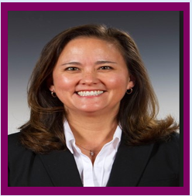
Jen
Experience
Technology & Web Use:
Intermediate
Packaging:
Expert
Context of use:
Quoting and sharing to herself
Preferred method of communication:
Email
Gains Knowledge by:
Laddawn.com, email, call
10 week activity:
Logins – 47
Finds – 105
Ext. Shares – 11
Jen’s story
Jen is new to Butler but has 27 years experience in packaging. She’s heard that Laddawn is great but that has not been her experience so far. She has a love/hate relationship with Lamika that typically revolves around “fire fighting” and not “educating” on the website.
She is extremely busy and has a stack of paperwork on her desk at all times. She would love to reduce it. She is efficient with technology but does not let it run her life. Her business is different than most because their orders are exclusively picked up, so planning is difficult when we do not have product ready on the scheduled date.
Challenges/Concerns:
She would like to get accurate confirmations in a timely manner.
She also needs items to be ready on the date they are acknowledged.
She would like better turnaround on credit when a return is made. She ends up calling/emailing Lamika every day.
Age: 45
Education: BA
Social Networks:
Facebook, Instagram, LinkedIn
Company Name:
Butler Dearden
Company Size: 45
Job Title: Purchasing Manager
Industry: Paper, Industrial, Janitorial
Tenure in Industry: 27 years
Business Type:
Mid-sized Distributor
Notes:
One of today's tasks is to replenish a whole bunch of layflat SKUS - about 20 in all in a wide range of sizes and mil thicknesses. Her boss said sales have been brisk in this category and inventories are low across the board. Does Laddawn have what we need in stock? (We would like to pick them up in Sterling.)
She also has a request for quote on her desk for some gusseted tubing – 12 x 4 x 2mil.

Slide 2
Mark
Experience
Technology & Web Use:
Novice
Packaging:
Expert
Context of use:
Product Info, Specs, Cert. Docs
Preferred method of communication:
Phone, Email
Gains Knowledge by:
Calls Reps, web research
10 week activity:
Logins – 18
Finds – 69
Ext. Shares – 2
Mark’s story
“I try to spend most of my day on the road visiting customers and seeking new business. We don’t have a purchasing team so we all source our own products. I work with about 40 vendors. We moved a lot of stock business to you years ago because you have a system that surpasses all others. We understand the value in what you guys do.”
He has been with Diversified for almost 20 years and is their top salesman. He typically works in the office for a short time each morning and then hits the road. Ordering from Laddawn takes much less leg-work. He emails PO’s to us most often and will call for rush/same day orders. He doesn’t order online, at work or in his personal life. He’ll call for pricing and info on products, but does not trust online ordering. He uses Microsoft in the office for email, etc.
Challenges/Concerns:
Mark says he doesn’t face a lot of challenges. He’s “old school” and has made adjustments only where he feels they were “necessary” to keep up with technological change. His one suggestion was “You should do what Box Partners does.”
Age: 59
Education: BA
Social Networks:
Facebook (doesn’t post)
Company Name:
Diversified Plastics & Pkg
Company Size: 5
Job Title: Outside Sales
Industry: Packaging
Tenure in Industry: 25 years
Business Type:
Mid-sized Regional Distributor
Notes:
He had heard from Andrew weeks ago about our printing capabilities, but he can't remember all the details. He just happened to be visiting a customer this morning and saw an opportunity to win some business on a printed zip top. "Can Laddawn print on both sides of an 8 x 10 zip top with sombrero hole?" he wonders. "Is it worth my taking the time to write up a request for quote?" He decides to check out our capabilities.

Slide 3
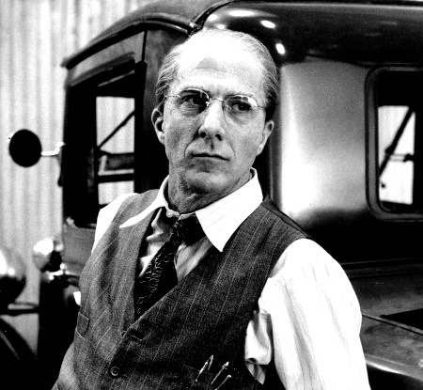
Herman
Experience
Technology & Web Use:
Basic
Packaging:
Expert
Context of use:
Searching, Ordering
Preferred method of communication:
Phone, email
Gains Knowledge by:
Calls Reps or emails questions
10 week activity:
Logins – 538
Finds – 156
Ext. Shares – 6
Herman’s story
“I’m on the phone a lot with customers. I’m the purchasing guy too. I place all of our orders and do follow-up. Laddawn has most of my business because you fit well for a small guy like me. I’m an old guy, I don’t do well with technology but I got a good lesson on your site. It’s not perfect but it’s good; better than everyone else's.”
He started Able in 1978. His son handles sales calls; his wife does bookkeeping. He fields calls and does all the ordering from home. He places most of his orders on Laddawn.com. He doesn’t own a smart phone and has no interest in social media “garbage.” Even though he’s on Laddawn.com every day, he refuses to explore. He searches for what he needs and orders it. It’s much more efficient than other vendors, from whom he orders via fax or email.
Challenges/Concerns:
He hates our bundling stage. “You have to admit it’s stupid to ask me twice how I want my order to ship” (for more than one bundle). He misses that often and says he “looks like a fool” when he tries to collect freight on “freight collect” orders after the fact. He asked “PLEASE fix that!” Our response time “isn’t what it used to be.”
Age: 60
Education: BA
Social Networks:
None
Company:
Able Plastics
Company Size: 3
Job Title: Owner
Industry: Packaging
Tenure in Industry: 41 years
Business Type:
Small, regional distributor
Notes:
My customer needs 15 cases of a 20 x 20 going to Westfield, NJ (07091) FAST. Is it available to ship today? I need to put this order in ASAP.

Slide 4
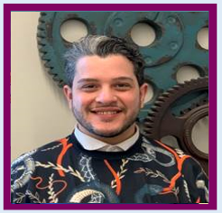
Andrew
Experience
Technology & Web Use:
Advanced
Packaging:
Novice
Context of use:
“Instructor” - teaches web benefits
Preferred method of communication:
Phone at work, email at home
Gains Knowledge by:
Web research, trial & error, co-workers.
Andrew’s story
Andrew describes himself as “a little nerdy.” He’s very comfortable with technology and enjoys tinkering with computers. His background is pretty diverse. He’s had purchasing experience as well as inside sales. His most recent position was at Deluxe Corp. in their Web division where he helped customers increase their presence on the internet. He loves being able to help distributors increase their sales and productivity by teaching them how to use the tools we’ve developed on Laddawn.com. He is measured by call quality and productivity.
Challenges/Concerns:
Andrew says his biggest challenge is getting the “Mark Cox’s” of the packaging world to fully understand the value in our website offers. He makes sure to tell those types of customers exactly what tool he’s using himself to help them find and source products.
Age: 34
Education: High School
Social Networks:
Facebook, Instagram, Linkedin, Snapchat
Job Title: CR
Tenure in Industry: 9 mos.
Notes:
He has a ton of calls and follow-ups to make today. For example, his customer Mark Cox has just emailed requesting pricing and availability for SKU 10245 for one customer…
… and a quote for an 8 x 10 Zip Top w/sombrero hole for another customer, printed on both sides, 2 colors, no art.

Slide 5
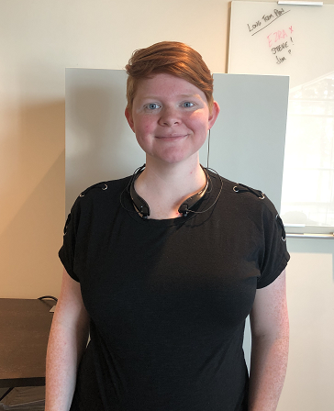
Abby
Experience
Technology & Web Use:
Fairly tech savvy, but not expert
Packaging:
Rookie
Context of use:
Transactional
Preferred method of communication:
Phone for speed, email for complex questions
Gains Knowledge by:
Classroom, but needs to “do it” to make it “click”
Abby’s story
Abby is new to Laddawn and the website. She has some prior experience in a warehouse setting with packaging and has done some shipping on E-Bay. She is fairly tech savvy and has moved through training at a steady pace. She feels she and her classmates are picking up the website fast. She admits that she has not been training on the “advanced sections” of the website.
Challenges/Concerns:
She struggles with product descriptions (both accuracy and the ability to search for item details). She has also noticed that her fellow new hires have struggled to integrate Excel and add supporting documents such as NAFTA and C of C.
Age: 26
Education: High School
Social Networks:
Facebook, Twitter
Job Title: CE
Notes:
It's afternoon and the queue is at 187. She takes a call from Bob West at Packaging Partners who wants MOQ, lead time and pricing for a 10 x 18 wicketed bag, 4" BG -custom due to dimensions. She will have to ask Bob about other features - cardboard backing, etc.
Once she finds his info, he wants to know what we have in stock, and have her put both into a cart and share with him. She wonders, do we stock this? Or does she even have to wonder?

