Slide 1
Tree Study
Evaluation of Laddawn’s New Information Architecture

Slide 2
Overview
Ran online remote tree test from 5/23-6/17 using Optimal Workshop’s “Tree Jack” tool.
15 product finding tasks, presented in random order to each participant.
88 participants, success rate overall – 76%
Customers (39) – 67%
Customer Experience (30) – 80%
Customer Relationship (19) – 85%
See spreadsheet with pivot tables which enable drilling down into segments further.
See online study results to drill into click paths and data visualizations.
Objectives
Validate new/modified top level categories – Can Liners, Food Service, Protective Packaging, Mailing & Shipping – do they help or hinder?
Validate streamlined structure
Validate category/product labels

Slide 3
Overall conclusions
The overall success rate doesn’t provide much actionable insight, but it does tell us that a majority of participants – in all segments - were able to complete tasks successfully.
The disparity between customer success rates (67%) v. our own staff (CE/CR combined, 82%) is somewhat concerning, but is also to be expected.
Takeaways and themes from task-by-task analysis:
Several opportunities for improving our labeling and possibly tweaking structure here and there.
New top level categories seemed to help for the most part.
“Protective packaging” led people astray on a few tasks, but worked well as a path to its intended targets. It seems like a viable (and more scalable) alternative to “Armor VCI” as a top level category.
Can Liners, Food Service, Mailing & Shipping seemed to improve overall findability.
In our business, there are some products that may simply require subject matter expertise to find – e.g. “clean room” bags.
Mega menus and more content and illustrations may help with product recognition and comparison.

Slide 4
Task-by-task analysis

Slide 5
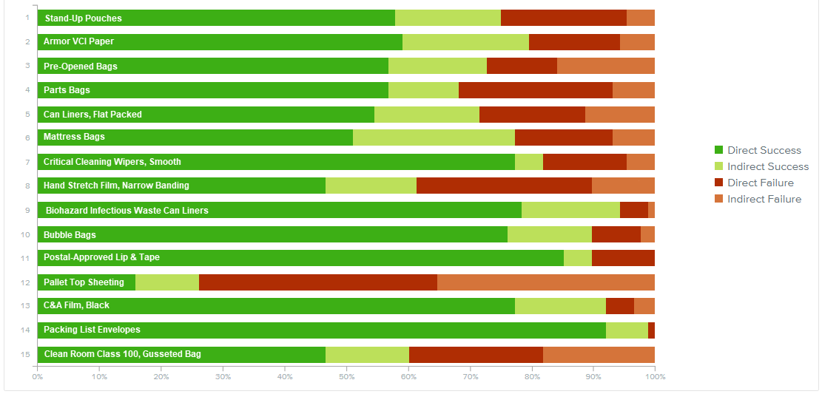
Task overview

Slide 6
Task-by-task analysis
Tree Jack assigns an overall score to each task on a scale of 1 to 10.
It is based on success rate, directness and time taken.
Our scores:
Score of 7 or above (color-coded green) is considered “well-performing” – 8 tasks.
Score of 5-6 (color coded blue) - middle of the road, ambiguous – 6 tasks.
Score of 0-4 – (color coded orange/red) - poor performers – 2 tasks.
The following slides presented lowest to highest scoring.

Slide 7
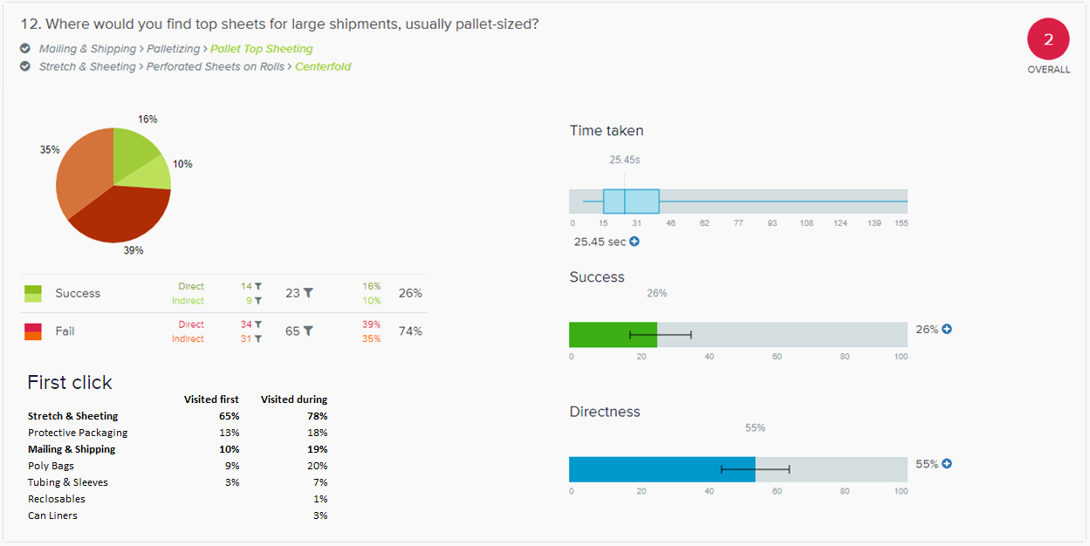

Slide 8
Findings – Pallet Top Sheets
Overall, 75% of participants went down the correct path initially.
Of those who selected the wrong answer (65 participants):
48 or 73% went down the correct path initially.
16 or 24% selected “pallet top covers” (technically a bag, not a sheet) as the answer (most of those who clicked Poly Bags first were looking for pallet top covers).
22 or 34% had something closer to the right idea in mind – they selected individually cut sheets in cases, or perforated sheets on rolls with a different wind.
Protective Packaging as a top level category led a group of 11 astray – not clear why - but 3 recovered to find the correct answer.
Of those who selected the right answer (23 participants):
12 or 52% chose “perforated sheets on rolls > centerfold.”
11 or 48% chose “pallet top sheeting.”
Perhaps “top” in the task primed participants – even seasoned CE/CR staff - to think “cover”?
“Pallet Top Sheeting” is not in our current menu structure, while we do call it out in the catalog. If we include it in the new structure, we should consider revising the label – even a small change like “sheets”?

Slide 9
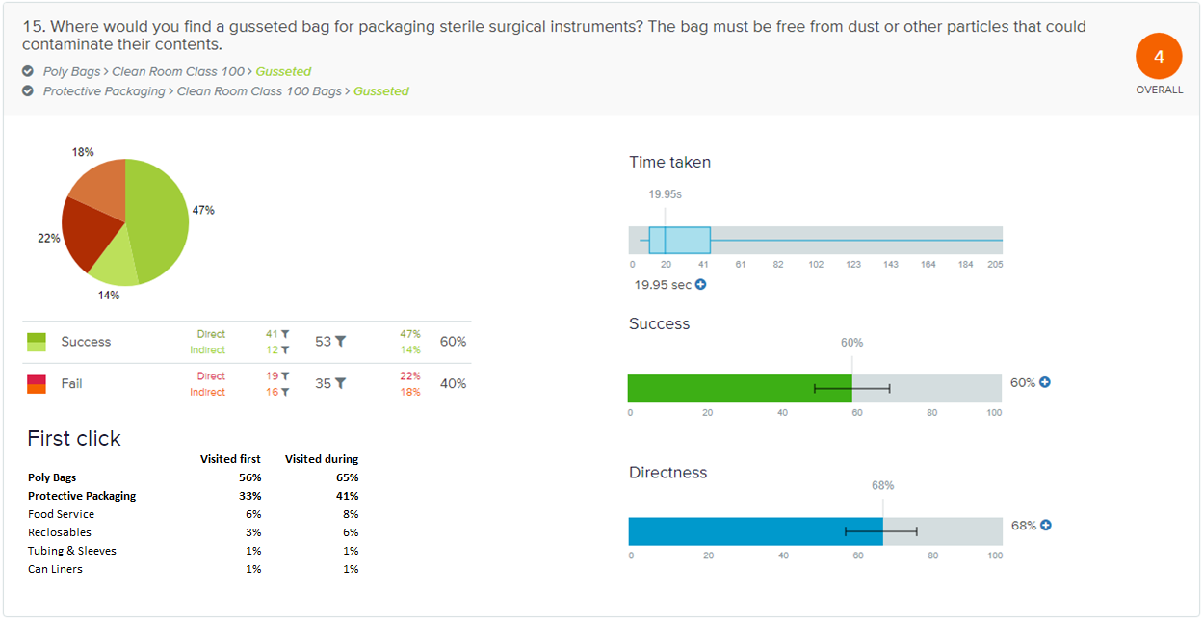

Slide 10
Findings – Clean Room Class 100, Gusseted
Overall, 89% of participants went down the correct path initially – a significant chunk (33%) opted for Protective Packaging.
Of those who selected the wrong answer (35 participants):
30 never made it to a “Clean Room” category.
5 managed to navigate to a “clean room” but 4 selected the wrong “clean room” class and bag (clean room class 200 zip top) or the wrong bag (clean room class 100 layflat).
18 participants passed through poly bags > healthcare on their journeys (not surprising given that surgical instruments were involved); 5 eventually found clean room by backtracking.
“Protective Packaging” proved to be an intuitive path for this category.
We should consider adding Clean Room to Poly Bags > Healthcare. Possibly Food Service too?
In the real world, would the task involve some priming – i.e. are distributors’ customers more likely to request “clean room” products by that name?
To some extent, this is a highly specialized category that may require advanced product knowledge.

Slide 11
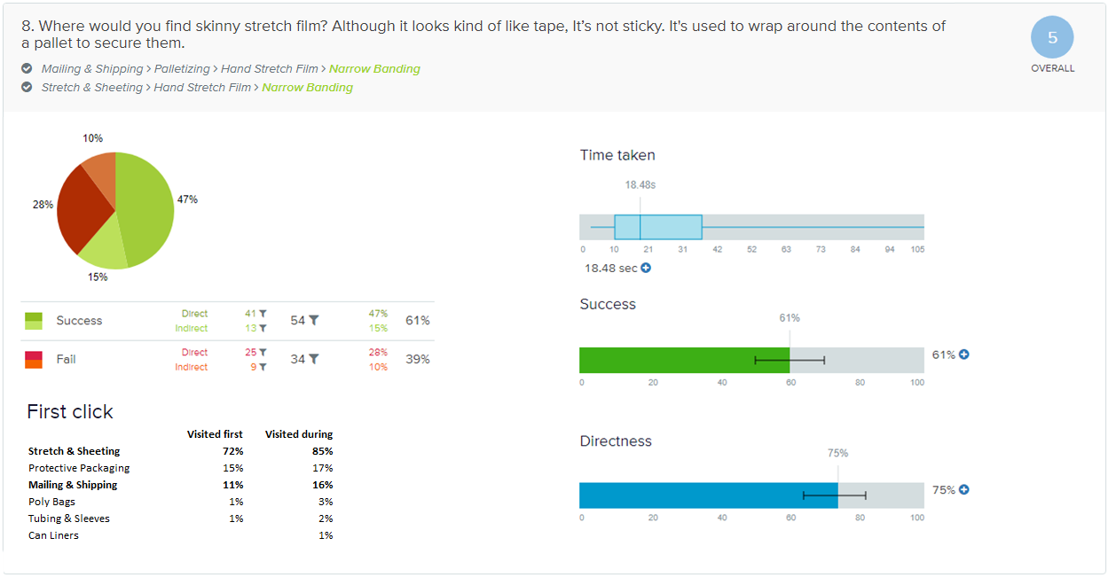

Slide 12
Findings – Hand Stretch Film, Narrow Banding
Overall, 88% of participants went down the correct path initially.
Of those who selected the wrong answer (34 participants):
The most popular incorrect answer was shrink bundling film (16)
13 correctly chose hand-stretch film, but chose the incorrect type (pre-stretched, 10; blown, 3)
1 chose continuous sheeting
4 chose something that was not film or even sheeting (bags, tubing)
5 of the searches that began with protective packaging ended up with the wrong answer; 8 ended up backtracking to arrive at the correct answer – possibly led astray by the word “secure” in the task?
It is reassuring that most users started down the right path. Ultimately stretch and shrink may be products that demand greater subject matter expertise to differentiate.
Product descriptions and images in the future mega menu may help users who have less product knowledge.
Protective Packaging led some people astray.

Slide 13
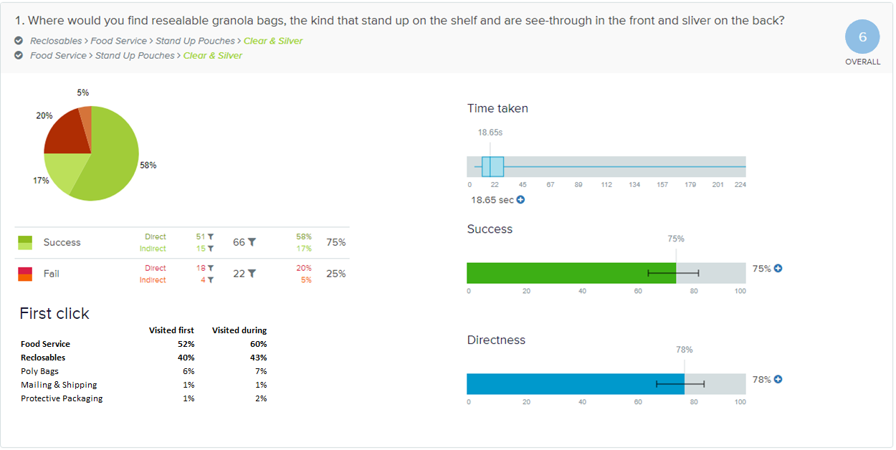

Slide 14
Findings – Stand Up Pouches, Clear & Silver
Overall, 92% of participants went down the correct path initially.
Of those who selected the wrong answer (22), most did so directly (18).
16 chose a stand up pouch with the wrong color (clear or silver, but not clear and silver).
Based on first clicks, the new top level category, “Food Service,” seems to have resonated with test participants.
If we discount incorrect color choices, the success rate for this task rises from 75% to 93%. Was this sloppiness in choosing the answer or genuine confusion over the choices?
Regardless, we ought to consider changing the label for this item to “Clear Front, Silver Back” to minimize confusion between the choices.

Slide 15
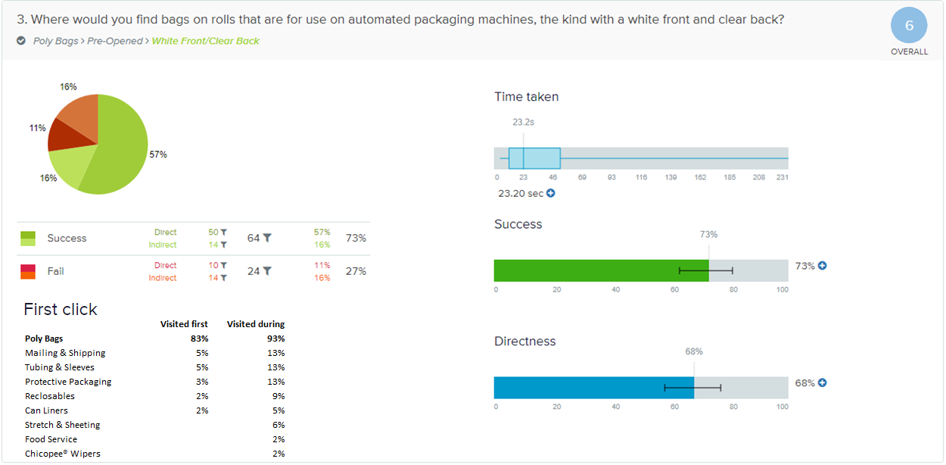

Slide 16
Findings – Pre-Opened Bags, White Front/Clear Back
Overall, 83% of participants went down the correct path initially, but from there, there were relatively high proportions of indirect success and indirect failure.
The most popular incorrect answer was Layflat Bag (12), followed by Gusseted Bag (4), Tubing (3), Sleeves (1), Zip Top, White Block (1), HD Can Liner, Coreless (1), Packing List Envelopes (1).
Interestingly, no one chose Pre-Opened Bags, Standard.
This is an important category; making improvements will require further consultation with Marketing concerning labeling and positioning.

Slide 17
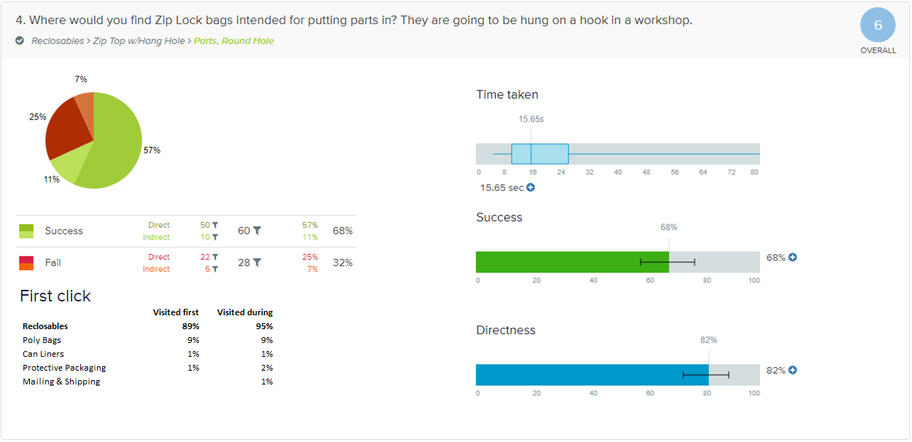

Slide 18
Findings – Zip Top, Parts, Round Hole
The vast majority – 89% - started out correctly in Reclosables.
However, 32% (28) chose the wrong response, though many had the right idea – to varying degrees - based on clues in the task:
Zip Top > White Block - 1
Zip Top w/Hang Hole > Round Hole > - 13
Zip Top w/Hang Hole > Polypropylene, Round Hole - 3
Static Control Zip Top Bags > Static Shielding – 1 (the reasoning may have been the material is suited to electrical “parts”?)
Zip Top > Standard - 6
A handful of others had no clue
Wicketed > Bottom Gusset, Low Density - 1
Layflat > 3
To streamline reclosables, we moved Parts bags to the Zip Top w/Hang Hole group. We should consider re-elevating it to the root level; we would not double list it in the hang hole group.
This is another example where pictures and descriptions in the mega menu may help with product recognition.

Slide 19
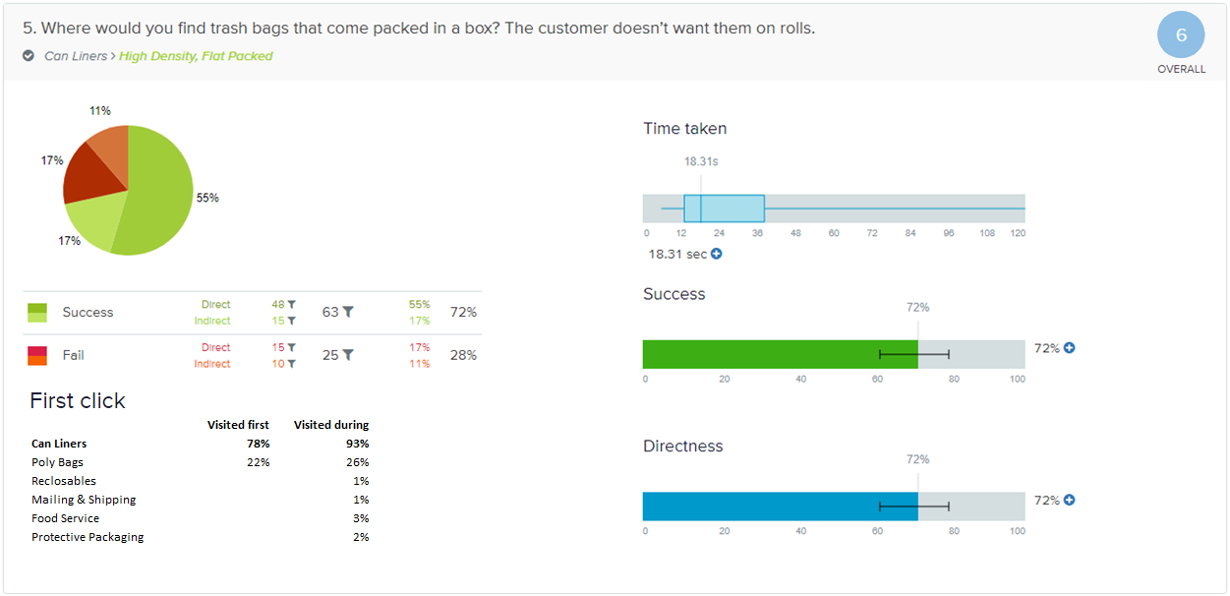

Slide 20
Findings – High Density Can Liners, Flat Packed
Overall, 78% of participants started out correctly with Can Liners. This seems like a high rate of recognition, considering that this is a new top level category, and that all of our internal and external users are accustomed to looking in Poly Bags.
Of the 25 participants who ultimately chose the wrong answer:
19 did so in spite of selecting the correct path (Can Liners) – initially or through back tracking.
10 ended up choosing Poly Bags > Layflat (5 directly; 5 indirectly).
For many users, there is a disconnect between “flat packed” in the category name and being packed in a box or case.
“Flat” in “Flat Packed” may have primed some users choose “Layflat” bags.
Unless “flat packed” is an important descriptor for distributors (are there case packed HD liners that are not “flat” packed?), should we consider renaming this “HD Can Liners, Case Packed”? Or removing the distinction from the menu, and making “flat packed” and “coreless rolls” options in the builder? We should consult with Dave O’Neill on these questions.

Slide 21
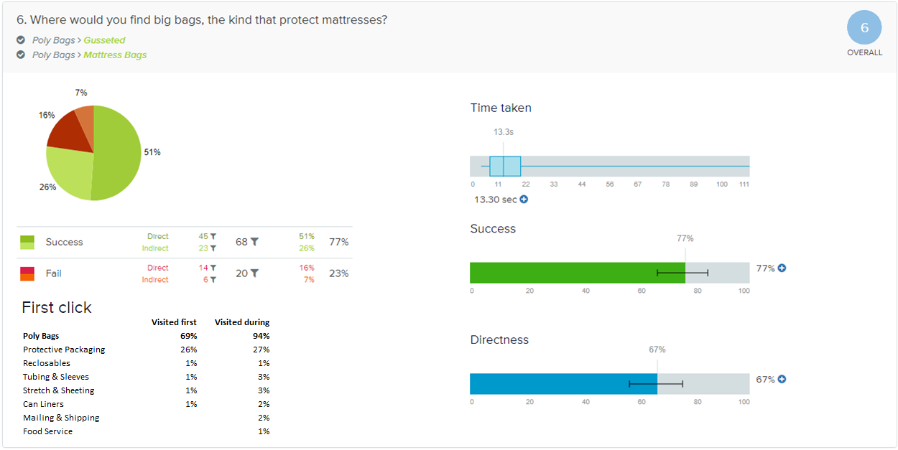

Slide 22
Findings – Mattress Bags
Overall, 69% of participants chose Poly Bags, the correct path, initially.
We theorize that our use of the word “protect” in the task primed 26% of participants to choose “Protective Packaging.” Seven participants who went that route recovered and chose the correct answer in Poly Bags.
Out of the 68 correct responses, only one participant chose Poly Bags > Gusseted.
Out of the 20 incorrect responses, 15 were Furniture Bags.
We suspect users scanned the list, arranged alphabetically after the top four categories (layflat, gusseted, wicketed, pre-opened), and upon seeing “furniture,” made a reasonable association between furniture and mattresses and did not bother to continue scanning.
We suspect more experienced distributors who are truly on a mission for mattress bags would be working with specifications for a gusseted bag and not make this mistake.
It’s possible that having dynamic illustrations in the mega menu may also help with scanning to locate the correct category.

Slide 23
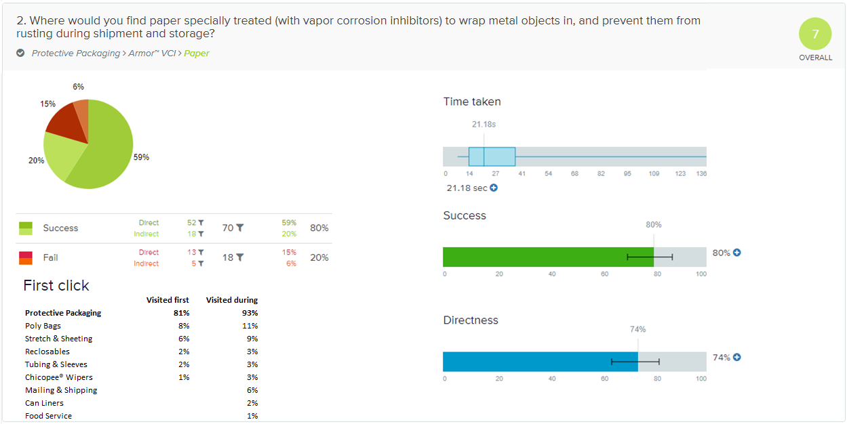

Slide 24
Findings – Armor® VCI Paper
Overall, 81% of participants recognized “Protective Packaging” as the correct path, and 80% answered correctly – this is considered a success.
Of the 18 incorrect responses, 6 selected an Armor VCI product – it just wasn’t paper.
The other 12 incorrect responses were all over the map – we suspect the novelty of searching for paper in a Laddawn menu may have thrown them off.
Although this new top level category led participants astray in a couple of other tasks, overall, it seems to be helping with findability of “protective” products, including but not limited to VCI.

Slide 25
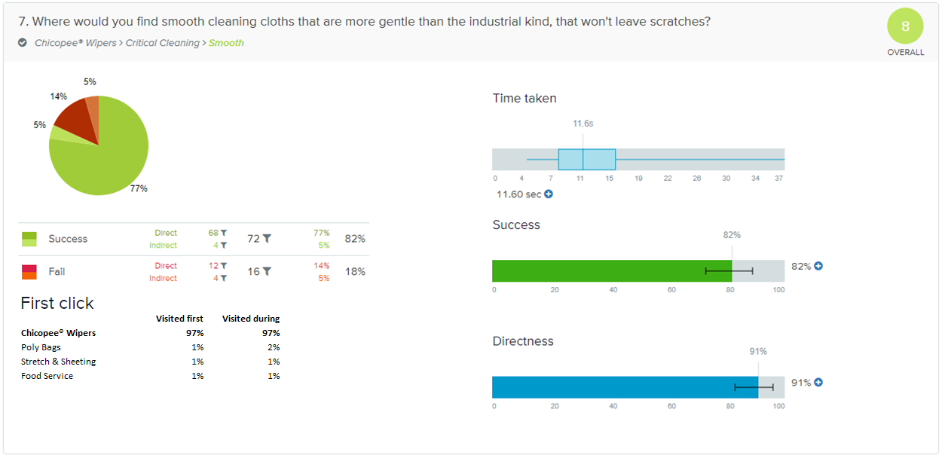

Slide 26
Findings – Critical Cleaning Wipers, Smooth
The vast majority of participants - 97% - started down the right path, so there was a high degree of association between cleaning cloths and Chicopee wipers.
An 82% success rate (most reaching the correct answer directly) can be considered a success.
Nevertheless, several participants who got the answer wrong chose the wrong type of wiper:
Shop Towels (5)
Industrial > Light Duty (6)
Industrial > Medium Duty (1)
The connection between “critical” cleaning and wipers that are “gentle” and “don’t leave scratches” is lost on some folks. Content and images in the mega menu may help with that.

Slide 27
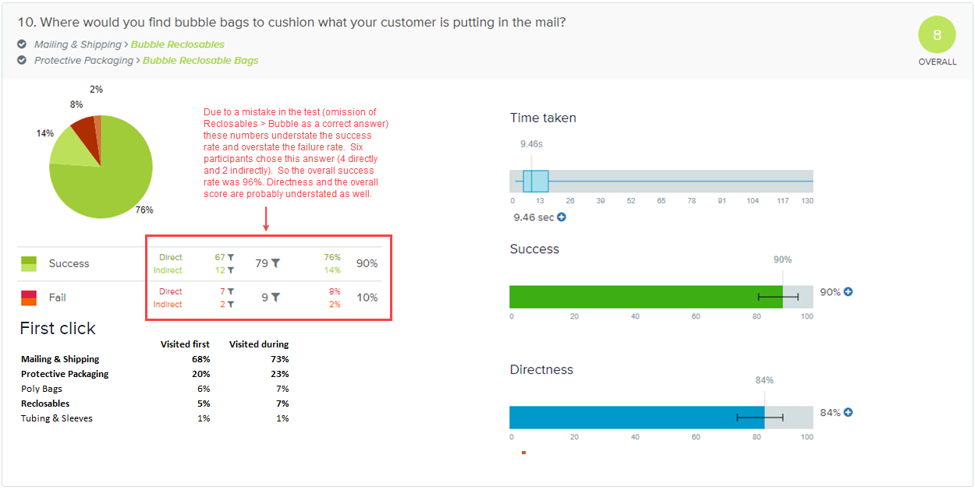

Slide 28
Findings – Bubble Reclosable Bags
The high overall score, and high rates of success and directness indicate that this product is highly findable.
Overall 93% of participants chose one of three correct paths.
The phrase “put in the mail” from the task may have primed many participants to choose the Mailing & Shipping path, and may account for this path’s dominance (68% of first clicks).
However for a smaller but significant chunk of participants (20% of first clicks) “Protective Packaging” resonated as something that would “cushion” its contents in the mail.
In our current information architecture, Bubble Bags exist only under Reclosables. Adding it to these other categories may have improved its findability - though we really can’t say for sure that, in the absence of these new categories, participants wouldn’t have found them under reclosables.

Slide 29
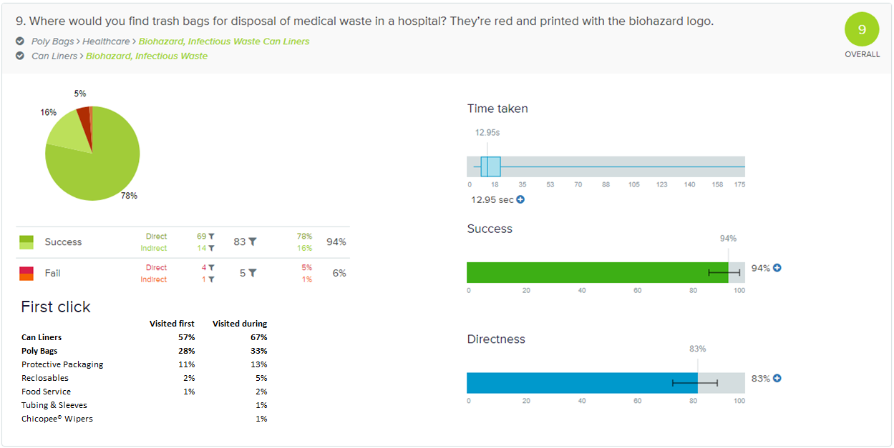

Slide 30
Findings – Biohazard Infectious Waste Can Liners
The high overall score, and high rates of success and directness indicate that this product is highly findable.
While the new top level category “Can Liners” was the preferred path, a sizable chunk of people were able to find these liners under Poly Bags > Healthcare.
The 5 participants who chose incorrectly all chose Poly Bags > Healthcare > Biohazard Specimen Zip Top Bags
This task touched on a couple of changes:
One, we plucked Can Liners as a broad, nested category out of Poly Bags and elevated it to be its own top level category.
Blurring of some lines. “Healthcare” is currently nested within Poly Bags under Can Liners; in our new structure, we elevated it and broadened it to include other “poly” bags one would associate with healthcare – they just happen to be reclosables.

Slide 31
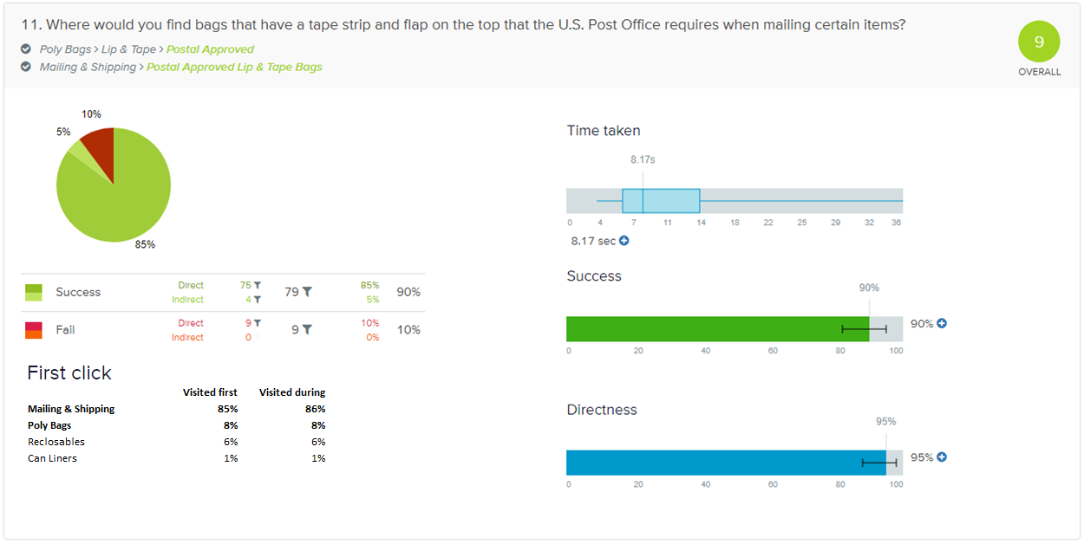

Slide 32
Findings – Postal-Approved Lip & Tape Bags
The high overall score, and high rates of success and directness indicate that this product is highly findable.
Of the 9 incorrect answers (all direct), 2 were poly mailers; 6 were lip & tape bags (of these, 4 were resealable lip & tape bags, newly added to Reclosables).
No changes recommended.

Slide 33
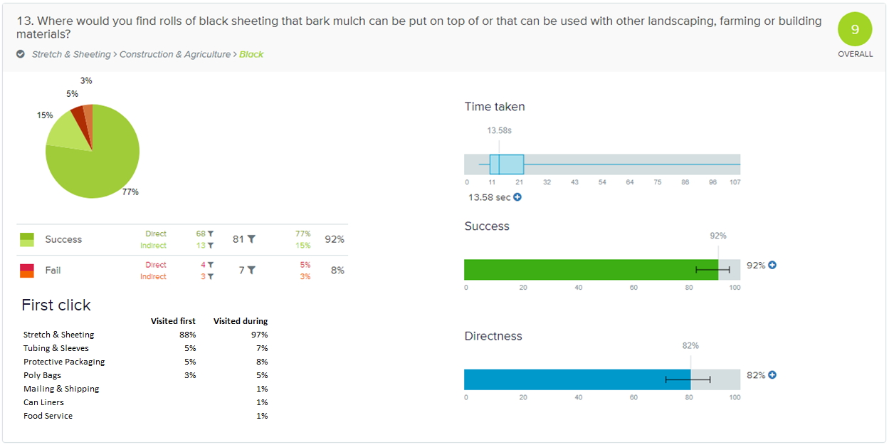

Slide 34
Findings – Black C&A Film
The high overall score, and high rates of success and directness indicate that this product is highly findable.
The incorrect answers (7) were all over the map (one was C&A Natural); we don’t think there are any actionable insights from these.

Slide 35
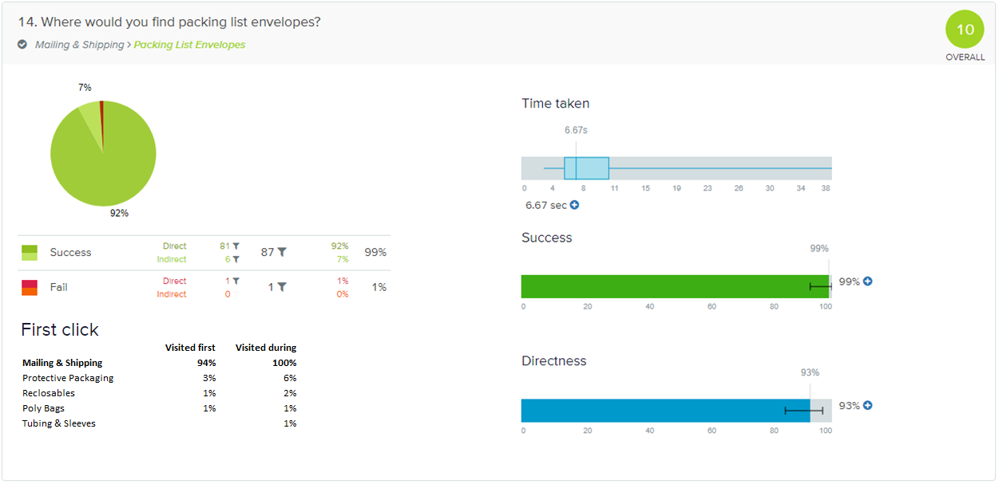

Slide 36
Findings – Packing List Envelopes
This was the highest scoring task in the study.
Since this is the only task where we used the name of the product (we could not think of any alternative descriptions that were not contrived or misleading) one could argue that priming contributed to its high success rate. It may have, but consider that participants still had to identify the correct parent category without any priming terms.
There was one incorrect answer; we don’t have any actionable insights.

