Slide 1
Laddawn.com 3.0
Redesign 2019

Slide 2
The Customer
“I wish Laddawn sold more of what I need. Many of my other vendors are difficult and I always worry they will mess up my order. I want to use Laddawn.com for everything, not just for regular polybags. Are you guys thinking of expanding into other categories? I would be your first customer.”

Slide 3
The Problem
Our existing Shop tab forces concessions in how we represent our product capabilities:
Add radio buttons
Over dependence on nested menus
Lean on broad search for stock only
This diminishes the user experience and slows down or prevents altogether the commercialization of new products that stand to grow sales and profit

Slide 4
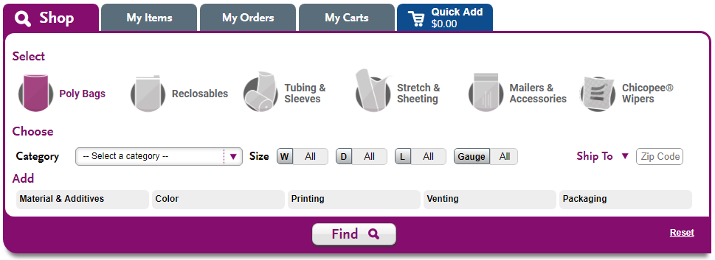
The Problem: Unwieldy Radio Buttons

Slide 5
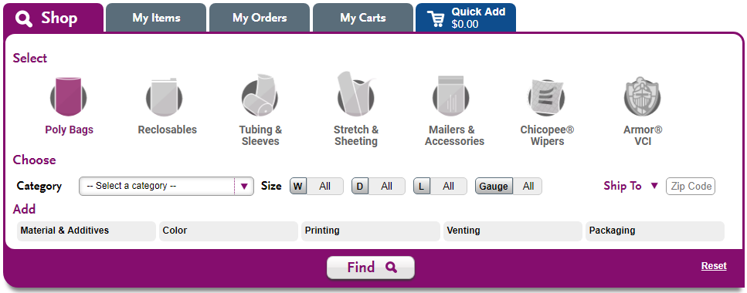
The Problem: Unwieldy Radio Buttons
Doubling Down!

Slide 6
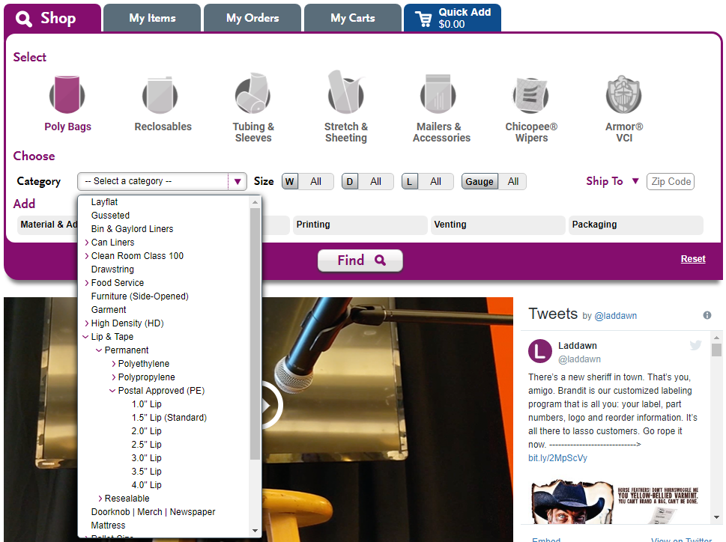
The Problem: Over-Nesting

Slide 7
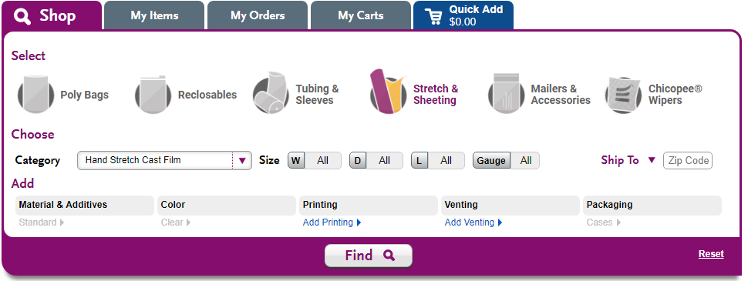
The Problem: “Broad Search Only”

Slide 8
The Answer: Redesign Laddawn.com
The Big Idea
Complete our transition to an e-commerce company
Goals
Build a product finding tool that:
is receptive to any and all kinds of products
shortens the product commercialization timeline
makes customers more aware of all the products we supply
makes customers more inclined to buy a broader array of product categories from Laddawn
makes the work of laddawn.com users easier, guided by the Model Service Experience

Slide 9
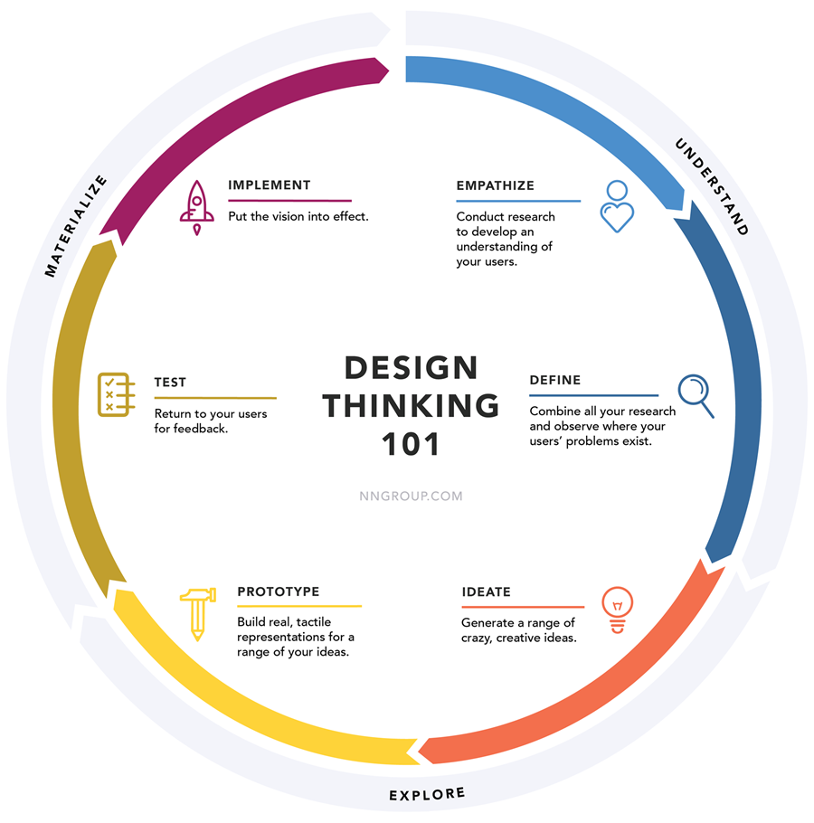
The Process: Design Thinking
Understand
Empathize
Define
Explore
Ideate
Prototype
Materialize
Test
Implement
Source: Nielsen Norman Group

Slide 10
Understand
Customer Visits
Personas
B2C research – customers at work are consumers at home
B2B research – best in class websites
B2C
Repair Clinic
Crutchfield
Etsy
Musicians Friend
Ebay
Staples
Nordstrom
Wayfair
Amazon
Home Depot
B2B
MSC
Grainger
Fastenal
Ferguson
E World Trade
Alibaba
Global Sources
Applied
McMaster

Slide 11
Ideate

Slide 12
Prototypes

Slide 13
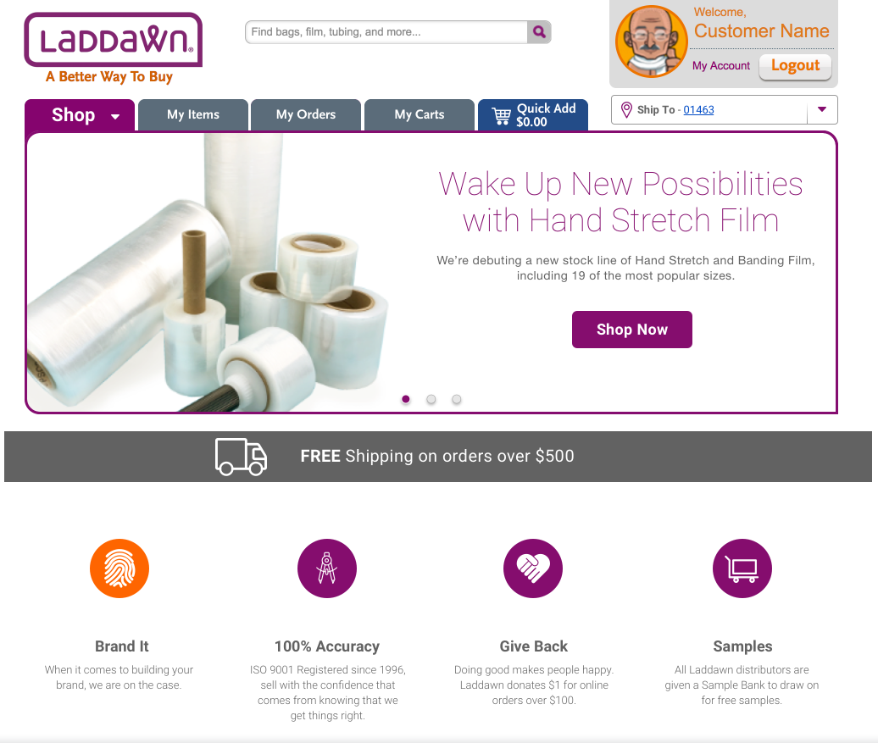
Home Page:
Hero Image/Carousel
Value Proposition
Product Spotlight
Other Marketing Content
Notes:
Hero images
Value prop

Slide 14
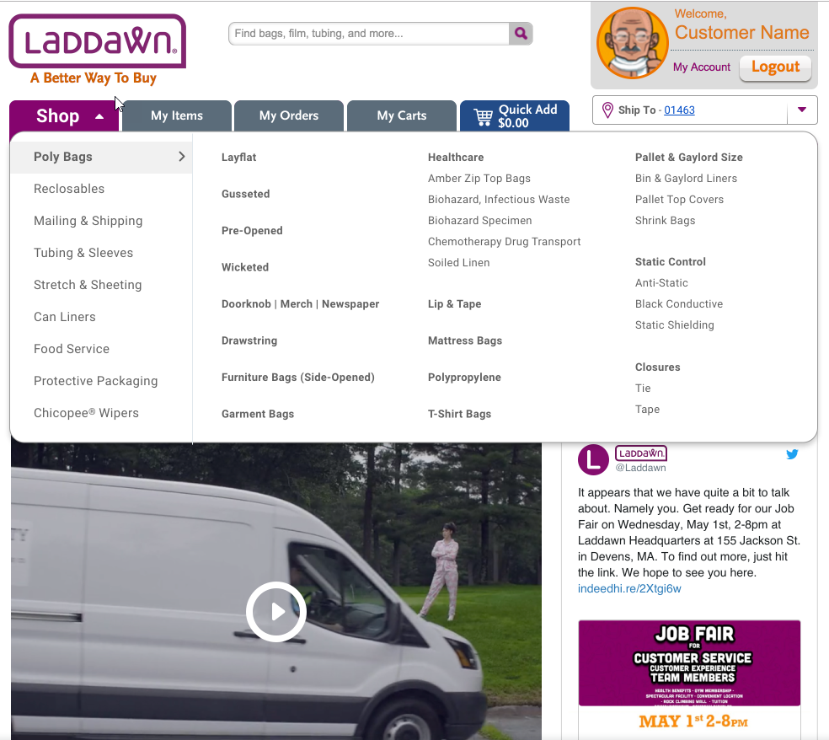
Mega Menu:
Breadth of Offering
Information Architecture*
Testing
Notes:
Mega menu
Helps achieve goals
Challenge: information architecture, IA testing (pallet cover finding)
Path = polybags, wicketed, tool to be named later

Slide 15
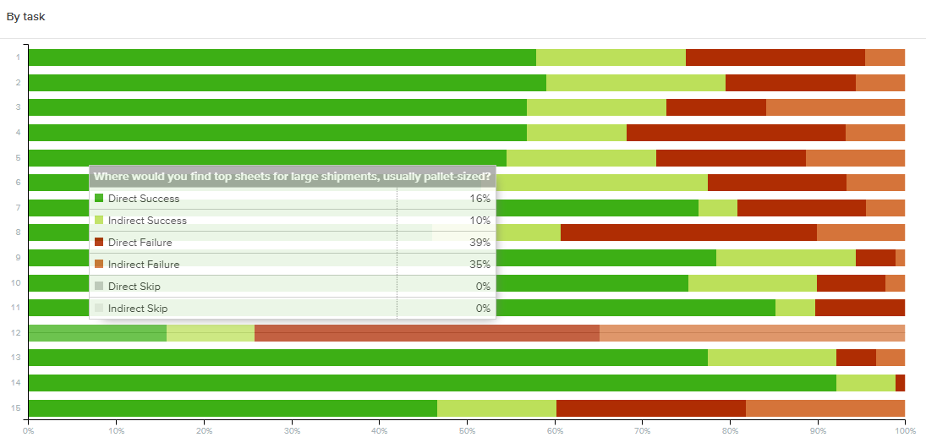
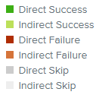
IA Testing
“You are not the user”

Slide 16
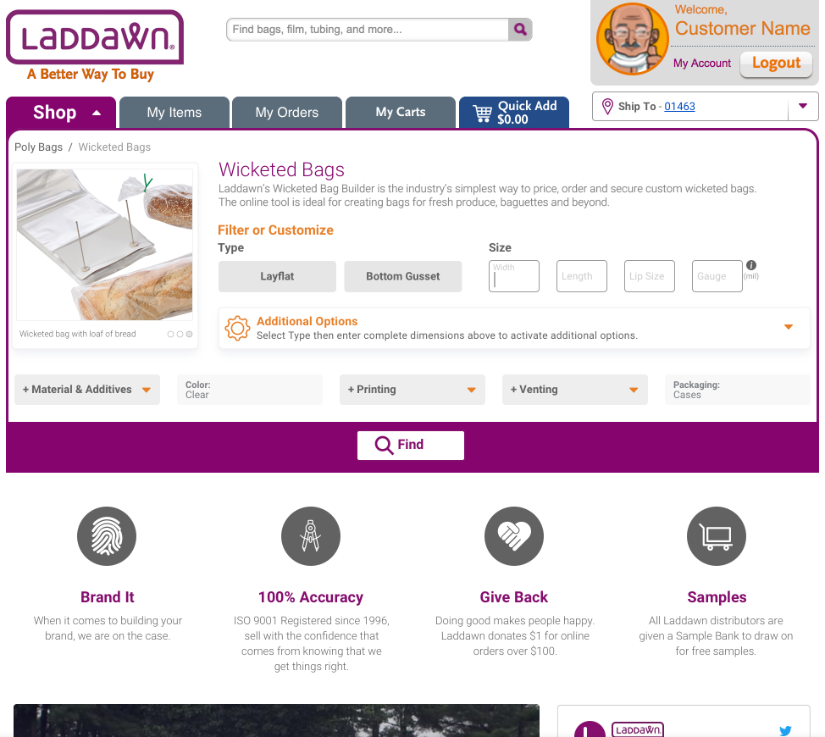
Notes:
Show current wicketed bag builder, keeping it and building off it for other categories
Illustrations, recognition, copy/descriptions earlier and not hidden
Most importantly, the back end will become more malleable (the database) to be receptive to any and all kinds of products
Click additional options….

Slide 17
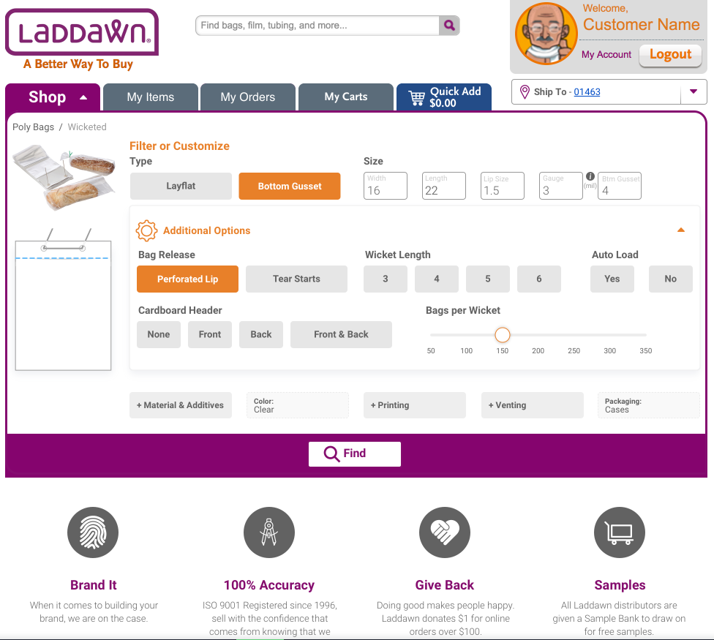
Notes:
Standardizing interfaces

Slide 18
